Slide 1


Peat in the Peak:
Restoring our Peatlands

Slide 2
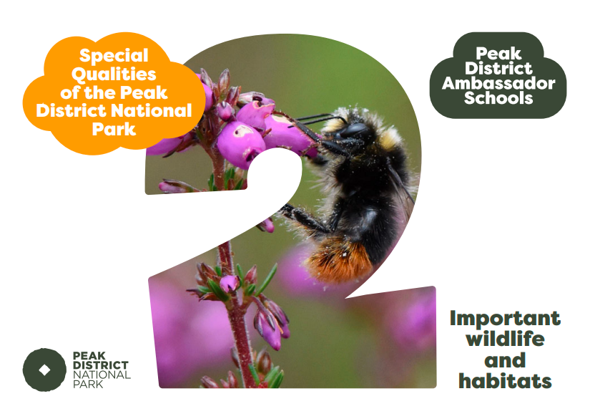
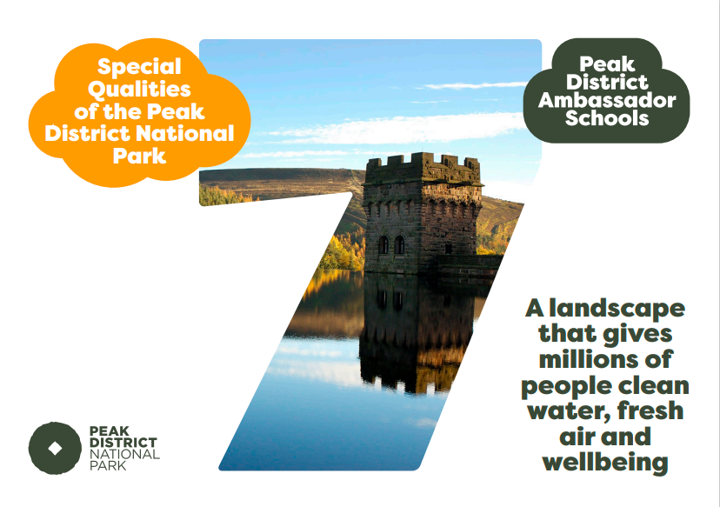

Slide 3
Key Vocabulary
Decompose - to rot or break down into its small components
Waterlogged – full of water (saturated)
Degraded – In a bad or broken state
Vegetation – a large group of plants growing together
Eroded – worn away by wind, water and human activity
Replenish –fill something up again
Restore – to bring back to how it was in the past
Biodiversity – the variety of plant and animal species living in a habitat

Slide 4
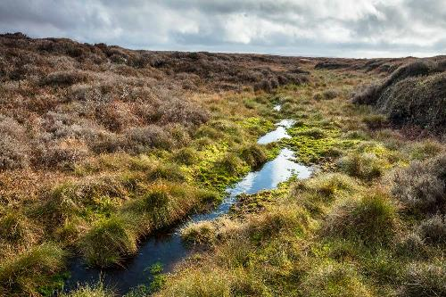
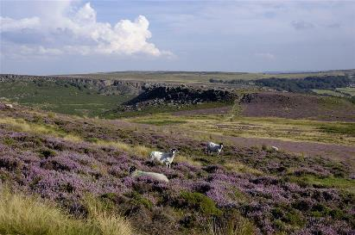
Quiz Time!
Time to find out how much you remember about the threats to the Peak District peat!
Your teacher will read out some of the quiz questions you created at the end of the last lesson, do you remember yours?

Slide 5
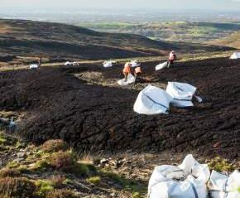
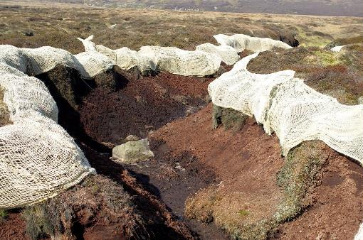
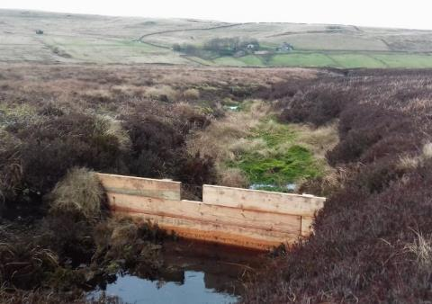
What’s being done to help?
Much of our peatlands are in an unhealthy condition due to past and current threats damaging them.
The Peak District National Park, Moors for the Future and others are working to make our peatlands healthy again.
Image: Moors for the Future
Image: Mike Serigrapher²
Image: Moors for the Future

Slide 6
What’s being done to help?
Can you find the answers to Activity 1 in these next 6 slides?
Making the peatlands healthy again takes a long time involving many different stages.
In this lesson we will look at just some of these stages and the difference they make over time.
Image: Moors for the Future
Image: Mike Serigrapher²
Image: Moors for the Future

Slide 7
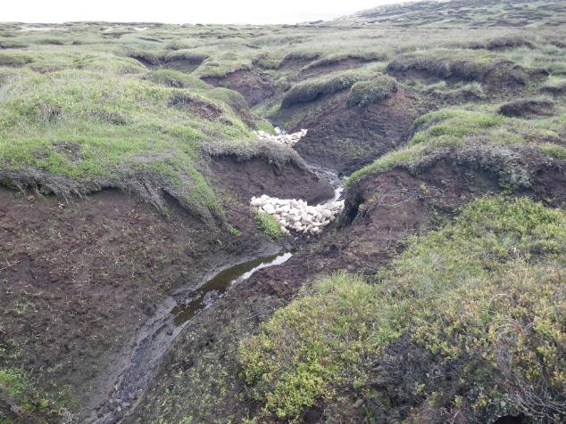
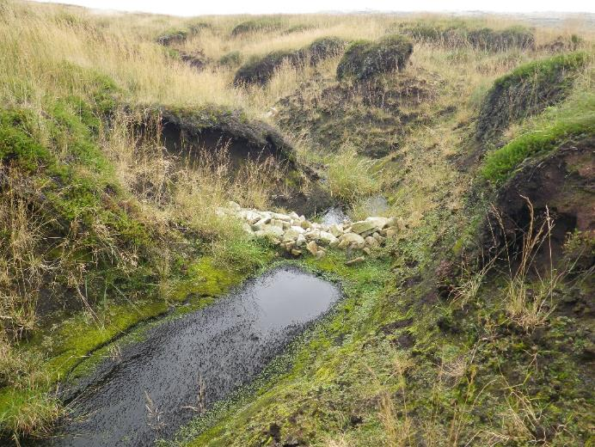
1. Building dams
Can’t find image source… think it’s PD or MoorsFF
What difference have the dams made in these photos?
After
Before
Notes:
Pictures from P:\CDO\Learning and Discovery\Landscape images\Before and after

Slide 8
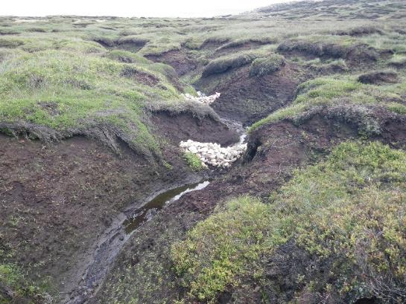

1. Building dams
Before
Stops water washing the peat away
Provides the wet conditions needed for more peat to form
Results in more moorland plants starting to grow
The plants protect the peat
After
https://www.moorsforthefuture.org.uk/our-work/our-projects/community-science-project
Notes:
Pictures from P:\CDO\Learning and Discovery\Landscape images\Before and after

Slide 9
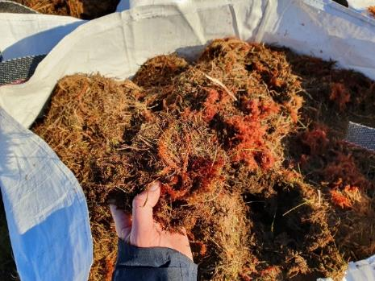
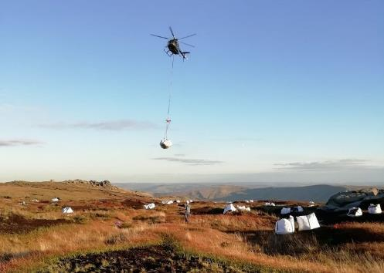
2. Spreading heather brash
Guess: How many bags of Heather Brash have ‘Moors for The Future’ spread?
Heather brash = heather branches containing seeds are spread by hand over the degraded peat
It protects the peat and heather seeds from being washed away by water
It allows new plants to grow and their roots help keep the peat in place
It is transported to the moor in large bags by helicopter
Image: Moors for the Future

Slide 10


2. Heather brash
Guess: How many bags of Heather Brash have ‘Moors for The Future’ spread?
Heather brash = heather branches containing seeds are spread over the degraded peat
It protects the peat and heather seeds from being washed away by water
It allows new plants to grow and their roots help keep the peat in place
It is transported to the moor in large bags by helicopter
11,000!
Image: Moors for the Future

Slide 11

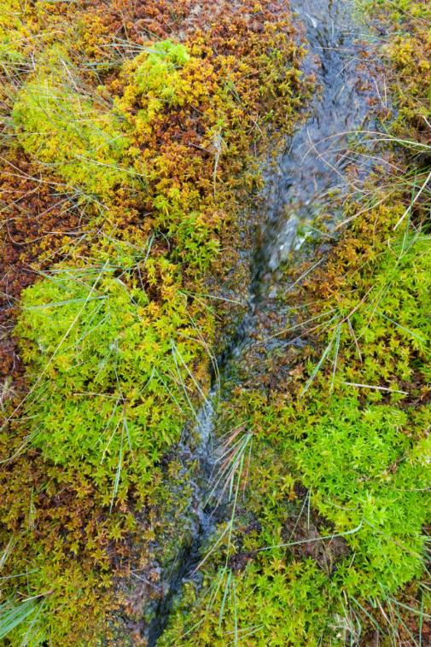
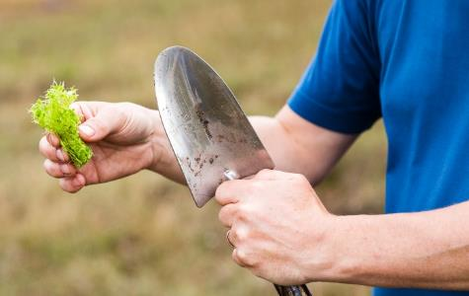
3. SuperMoss!
Once the vegetation is developing sphagnum moss is planted
Guess: Sphagnum can hold ?? times its’ own weight in water?
Up to 20 times!
Could you absorb 20 watery versions of yourself?
Image: Moors for the Future
Image: Moors for the Future

Slide 12
3. SuperMoss
Sphagnum can grow across the peatland like a huge spongey blanket!
It absorbs and holds so much water that it keeps the whole area waterlogged.
Spongey sphagnum moss on high ground means less water washing down into rivers during times of high rainfall.
Image: Moors for the Future
Image: Moors for the Future

Slide 13
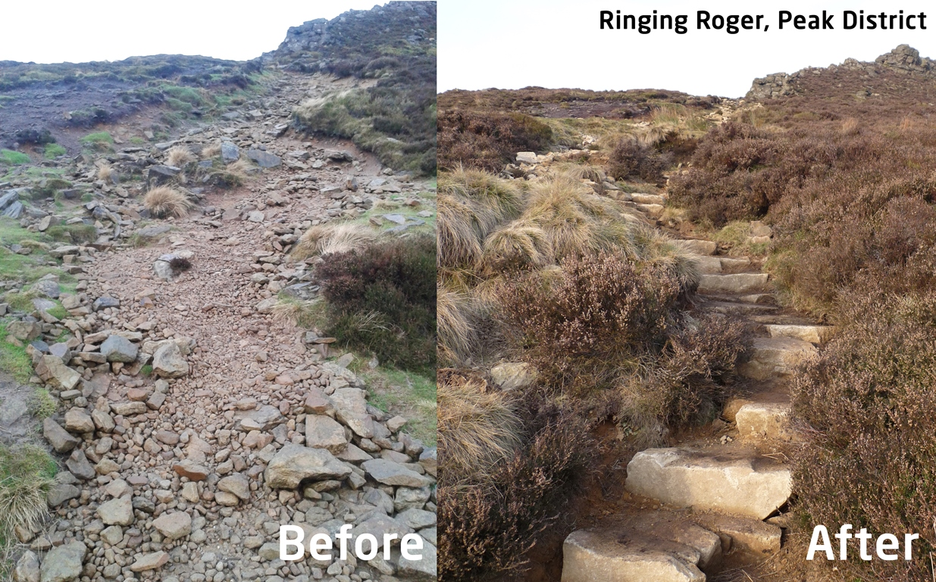
4. Resurfacing paths
New, harder surfaces are added to pathways to encourage visitors to use them.
This reduces erosion caused by the many visitors who walk in the Peak District each year.
Can you guess how many people visit the Peak District National Park every year?
13.25 million visitors to the Peak District each year!
Images: Mend our Mountains

Slide 14
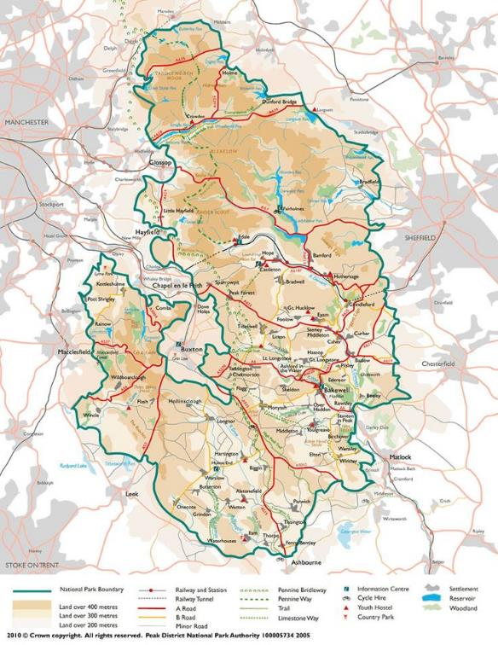

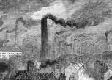
Activity 2: Restoring the damaged peat on Black Hill, Peak District National Park
Black Hill is located here at the far North of the Peak District National Park.
Smoke
Acid Rain
Can you name the big industrial city to the West of Black Hill?
Can you find where your school is on the map?

Slide 15

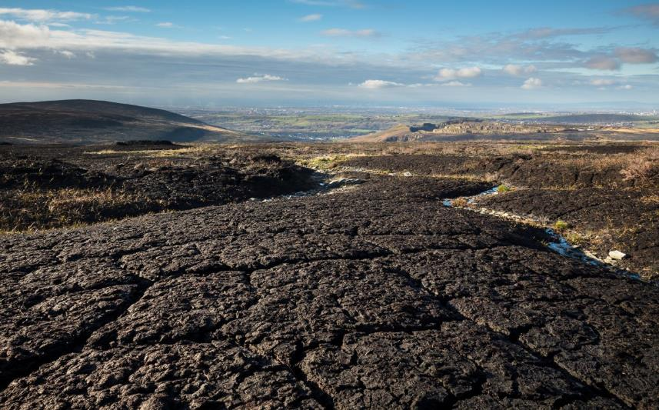
BLACK HILL: How it’s changed since the 1800’s
CO₂
CO₂
By the 1970’s acid rain from Manchester had killed the vegetation on the blanket bog and exposed large areas of peat. The peat was now easily eroded by wind, rain and walkers. The damaged peat released CO₂ into the air.
This is how Black Hill will have looked before the Industrial Revolution of the 1800’s…a healthy blanket bog with a big variety of plants, animals, and waterlogged ground this was a perfect habitat to store CO₂.

Slide 16
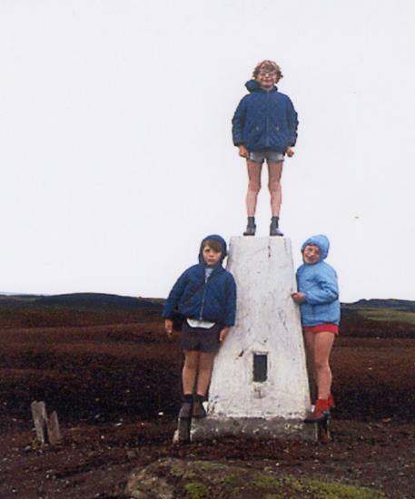
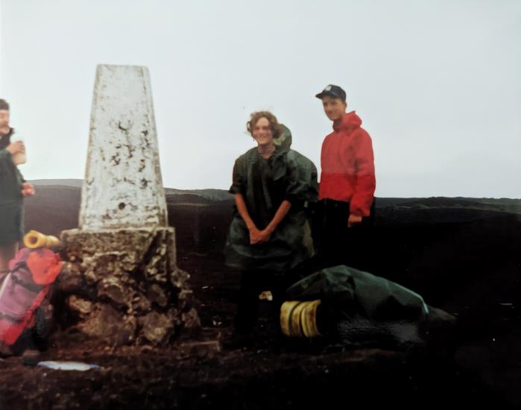
Black Hill: Erosion of peat on the Pennine Way
Use these slides to help you with Activity 2
1976
1990
The same trig point on Black Hill 14 years apart…can you work out how much of the peat around the trig point has been eroded away?
Clue …the lad in the red coat next to the trig point in 1990 is tall and his feet are on the peat!
Ground level

Slide 17
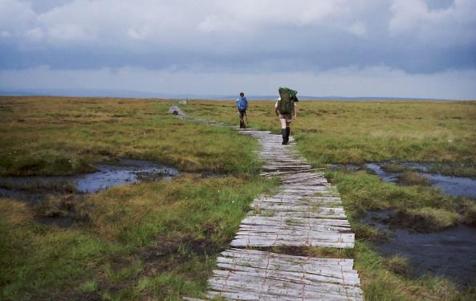
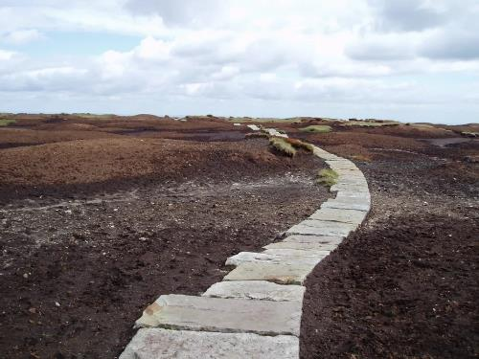
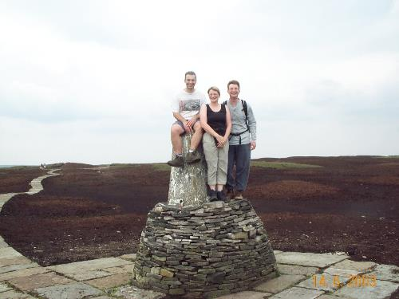
Restoring Black Hill:
Use these slides to help you with Activity 2
1980’s - wooden walkways were laid across the wet moor
2003 – a new gritstone path is built over eroded peat
2003 a new wall was built to protect the trig point
Image: Chris Sainty
These failed: Why do you think they didn’t work?
Clue: It’s to do with what happens to wood when it gets wet.
These stone slabs were brought to the moor from old mill buildings in the big cities around the Peak District: Is this recycling or reusing?
Look at the ground behind the trig point: What colour is it? Are there any plants (vegetation) there?
Notes:
Left image this slide and next: Moors for the Future: Peak District National Park

Slide 18

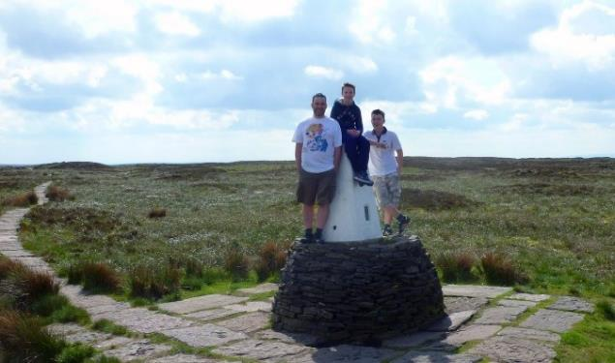
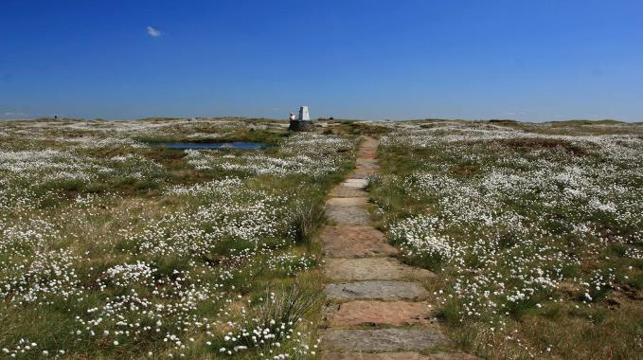
Restoring Black Hill:
Use these slides to help you with Activity 2
2003
2016
2016
What changes on the ground can you notice from 2003 to 2016?
Do you think the restoration has been successful?
If there are more plants what else will there be more of now?

Slide 19
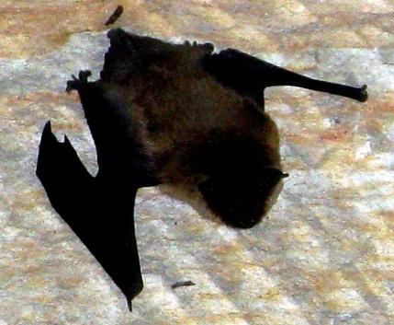
How has restoring the peat in the Peak improved biodiversity?
In Sept 2022 the Moors for the Future Project spotted bats on Kinder Scout at the highest altitude ever recorded in Derbyshire!
Why are bats a good sign for the peat moorland?
Clue: What do bats eat?
Notes:
P:\CDO\Learning and Discovery\Alan's Photo's

Slide 20
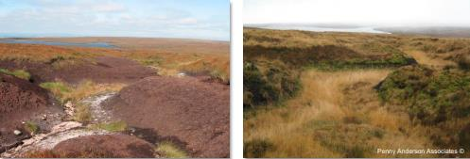
How has the peat in the Peak improved?
As of Sept 2022 the Moors for the Future Project have:
  Restored 35km² of moorland in the Peak District and South Pennines over the last 20 years.
That’s nearly 5,000 football pitches!
Before
After
Image: Moors for the Future
Image: Moors for the Future

Slide 21
Create a timeline of what has happened to peat in the Peak since the 1800’s.
1800’s
Today
Hints:
What did the peat look like before the Industrial Revolution in the 1800’s?
What caused the vegetation to disappear from the moorland between 1800 and the 1970’s?
How much peat had disappeared on Black Hill by the 1990’s?
What methods did they use to try to prevent more damage from the Pennine Way walkers and restore the peat?
What methods have been used by Moors For the Future to help restore the blanket bog and protect the peat?
What changes have taken place since 2003?
How has biodiversity improved on Black Hill?

Slide 22
How can you help?
Avoid walking off paths onto bare soil where possible to prevent damage to vegetation and erosion.
Don’t light fires or BBQs on the moorlands – you could accidentally cause a much bigger fire! This is illegal within the Peak District National Park open countryside.
Ask people you know to buy peat–free compost to use in their gardens.
Why not volunteer with your family to help look after our National Park or collect information on the animals and plants there?
  PPCV Individuals: Peak District National Park
  Citizen science surveys and sightings | Moors for the Future

Slide 23
Image Permissions
  Photo licencing
    If no reference given the Peak District owns or has full permission to use the image
    If referenced and followed by ¹ the following Creative commons license applies: Creative Commons — Attribution 2.0 Generic — CC BY 2.0
    If referenced and followed by ² the following Creative commons license applies: Creative Commons — Attribution-NonCommercial 2.0 Generic — CC BY-NC 2.0

