Slide 1
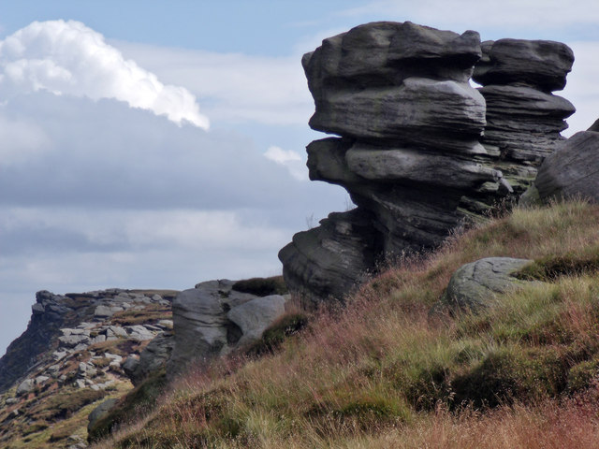

Slide 2
What’s so special about rocks ?????

Slide 3
So why are rocks important?

Slide 4
Rocks can be used to BUILD walls, buildings, bridges…..all sorts of things.
So why are rocks important?

Slide 5
Rocks can be used to BUILD walls, buildings, bridges…..all sorts of things.
We use materials that come from rocks such as METALS.
So why are rocks important?

Slide 6
Rocks can be used to BUILD walls, buildings, bridges…..all sorts of things.
We use materials that come from rocks such as METALS.
So why are rocks important?
The type of SOIL on the ground is determined by the rocks underneath it.

Slide 7
Rocks can be used to BUILD walls, buildings, bridges…..all sorts of things.
We use materials that come from rocks such as METALS.
So why are rocks important?
The whole PLANET is made of rock. Without rock we wouldn’t be standing on anything!!
The type of SOIL on the ground is determined by the rocks underneath it.

Slide 8
How are rocks formed?

Slide 9
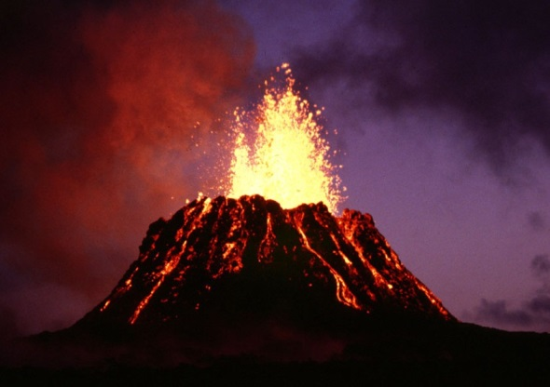
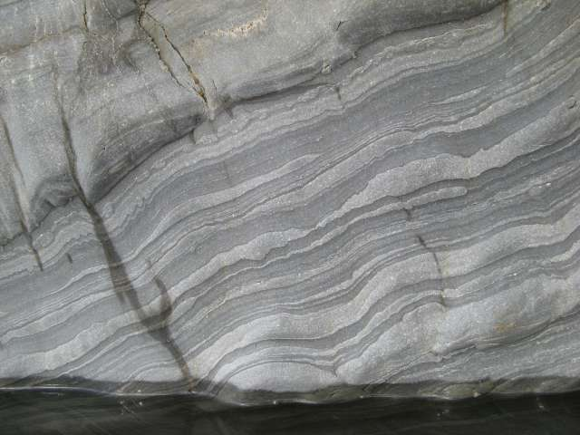
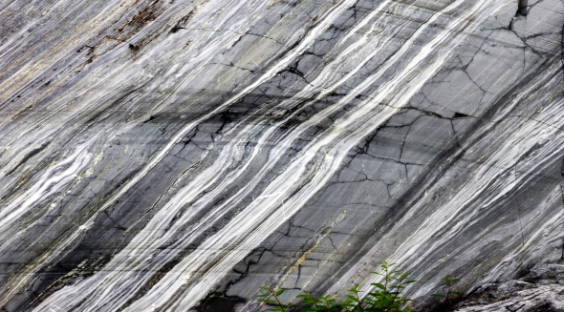

Slide 10
Lava from beneath the Earth’s crust reaches the surface and cools. These are called igneous rocks.

Slide 11
Lava from beneath the Earth’s crust reaches the surface and cools. These are called igneous rocks.
Small rock particles or the hard shells of animals form layers. These are called sedimentary rocks.

Slide 12
Lava from beneath the Earth’s crust reaches the surface and cools. These are called igneous rocks.
Small rock particles or the hard shells of animals form layers. These are called sedimentary rocks.
Pressure and heat change the rocks. These are called metamorphic rocks.

Slide 14
Both sedimentary and metamorphic rocks can be pushed back into the earth’s mantle so the rock cycle can begin again.

Slide 15
Are all rocks the same?

Slide 16
Are all rocks the same?
Time to get testing!

Slide 17
Are all rocks the same?
Rocks can be all sorts of colours, depending on the minerals within them. Some, like marble, can be used to make attractive sculptures.

Slide 18
Some rocks are permeable (water soaks into it) while some are impermeable. Other rocks are porous – they have holes where the water can flow through, like limestone.
Are all rocks the same?
Rocks can be all sorts of colours, depending on the minerals within them. Some, like marble, can be used to make attractive sculptures.

Slide 19
Some rocks are permeable (water soaks into it) while some are impermeable. Other rocks are porous – they have holes where the water can flow through, like limestone.
Are all rocks the same?
Some rocks are very hard, like granite. Others are very soft, like talc.
Rocks can be all sorts of colours, depending on the minerals within them. Some, like marble, can be used to make attractive sculptures.

Slide 20
Some rocks contain layers, grains or crystals. Some others may contain fossils or metals.
Some rocks are permeable (water soaks into it) while some are impermeable. Other rocks are porous – they have holes where the water can flow through, like limestone.
Are all rocks the same?
Some rocks are very hard, like granite. Others are very soft, like talc.
Rocks can be all sorts of colours, depending on the minerals within them.
Some, like marble, can be used to make attractive sculptures.

Slide 22
What types of rocks will you see in the Peak District?

