Slide 1
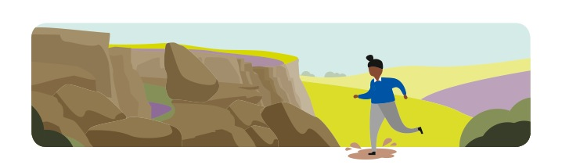

KS2 Peak District Wildlife
Food Chains

Slide 2
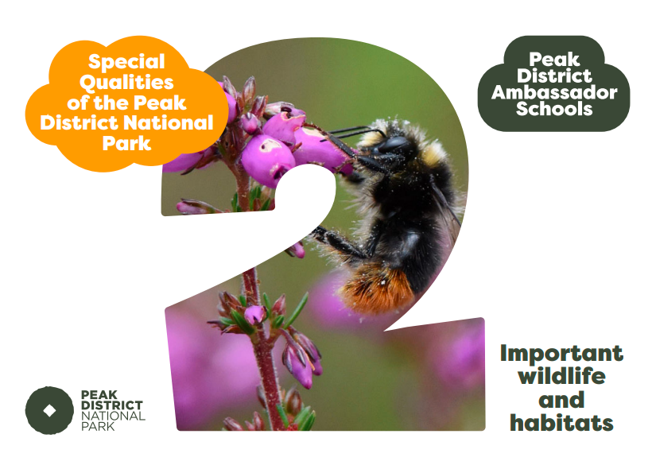

Slide 3
Glossary
Habitat – the environment/area where an animal or plant makes it’s home
Food Chain – A chain showing how plants and animals get their energy
Producer – Plants which make their own energy from the sun
Consumers – Animals which get their energy by eating other things
Predator- An animal (or plant) that eats another animal
Prey – An animal a predator eats
Pesticide - Chemical used to kill pests (insects or weeds).

Slide 4
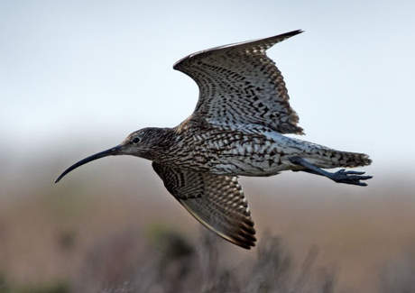
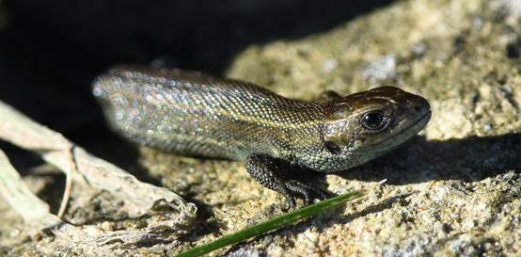
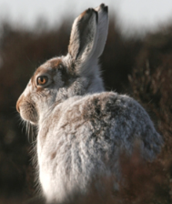
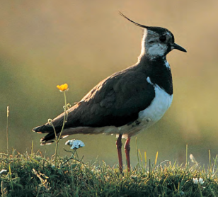
Special Quality 2: Important Wildlife and Habitats
One of the reasons the Peak District is a National Park is the important wildlife and habitats that you find there.
We are going to look at some of the special wildlife you could spot in the Peak District National Park!
SNOW!

Slide 5
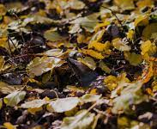
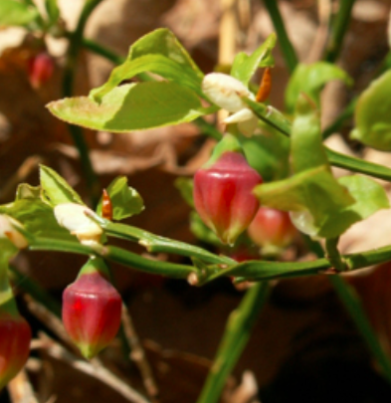
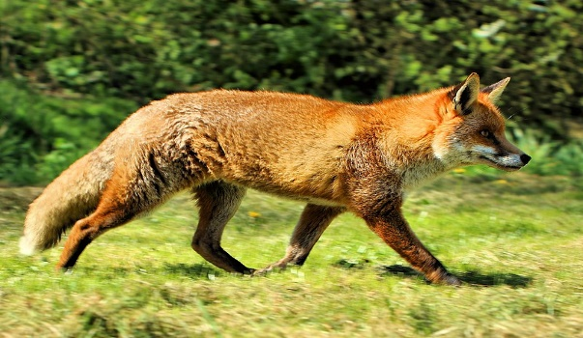
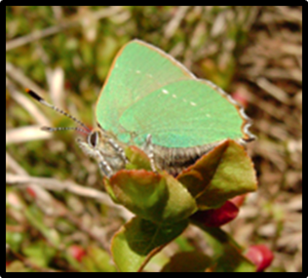
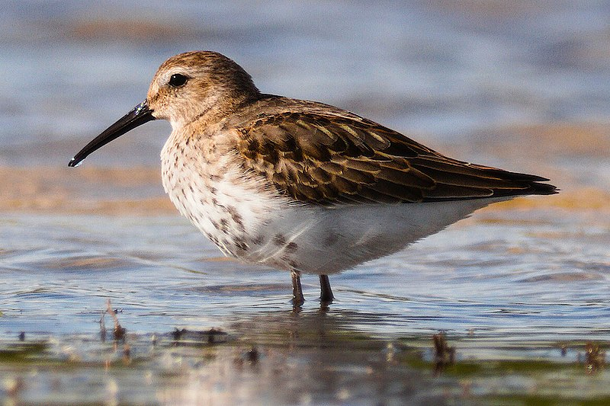
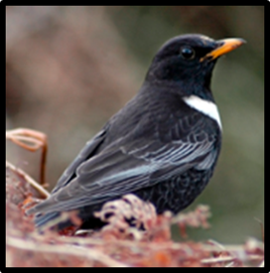
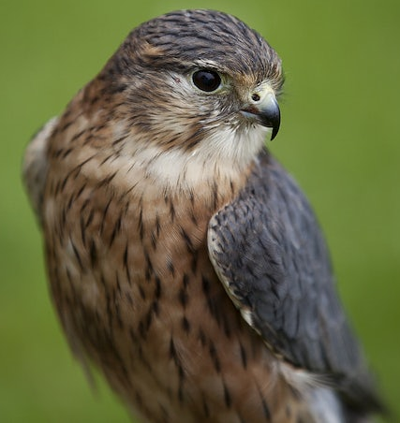
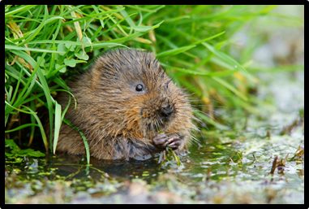
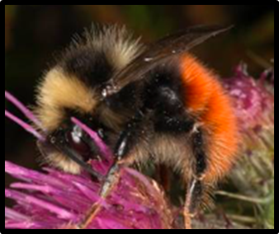
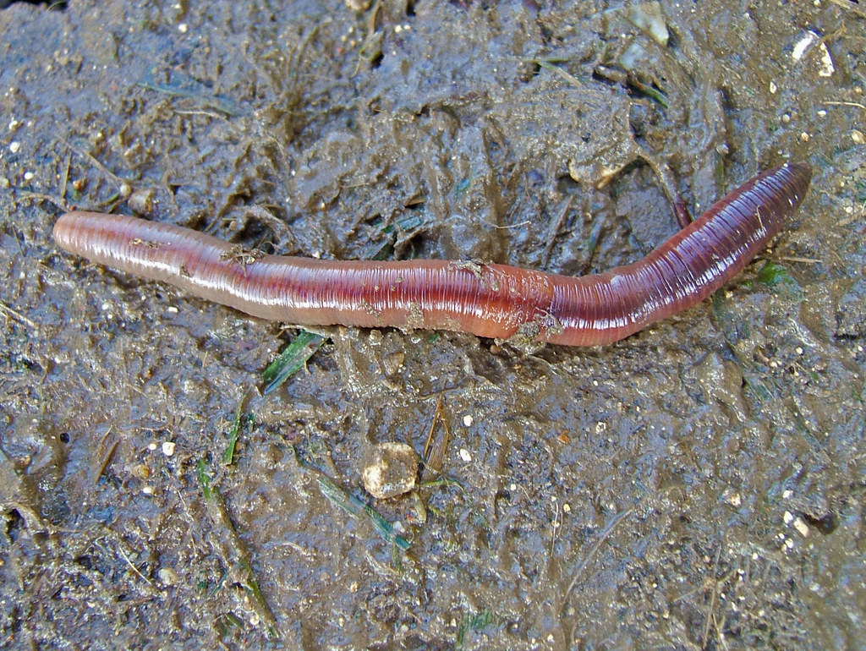
Peak District Wildlife
Within the Peak District there are lots of different plants and animals, which means there are LOTS of different food chains!
Myhill.bob³
Airwolfhound
Squeezyboy¹
Can you name any of the animals/plants shown above?

Slide 6
Peak District Wildlife
What different types/groups of animals can you spot?
Myhill.bob³
Airwolfhound
Squeezyboy¹
Clue: Mammals/Predators/Insects/Prey/Herbivores/Birds/Omnivores/Carnivores: Some animals can be in more than one group.

Slide 7
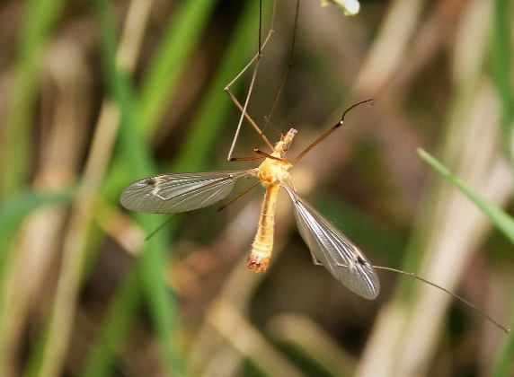
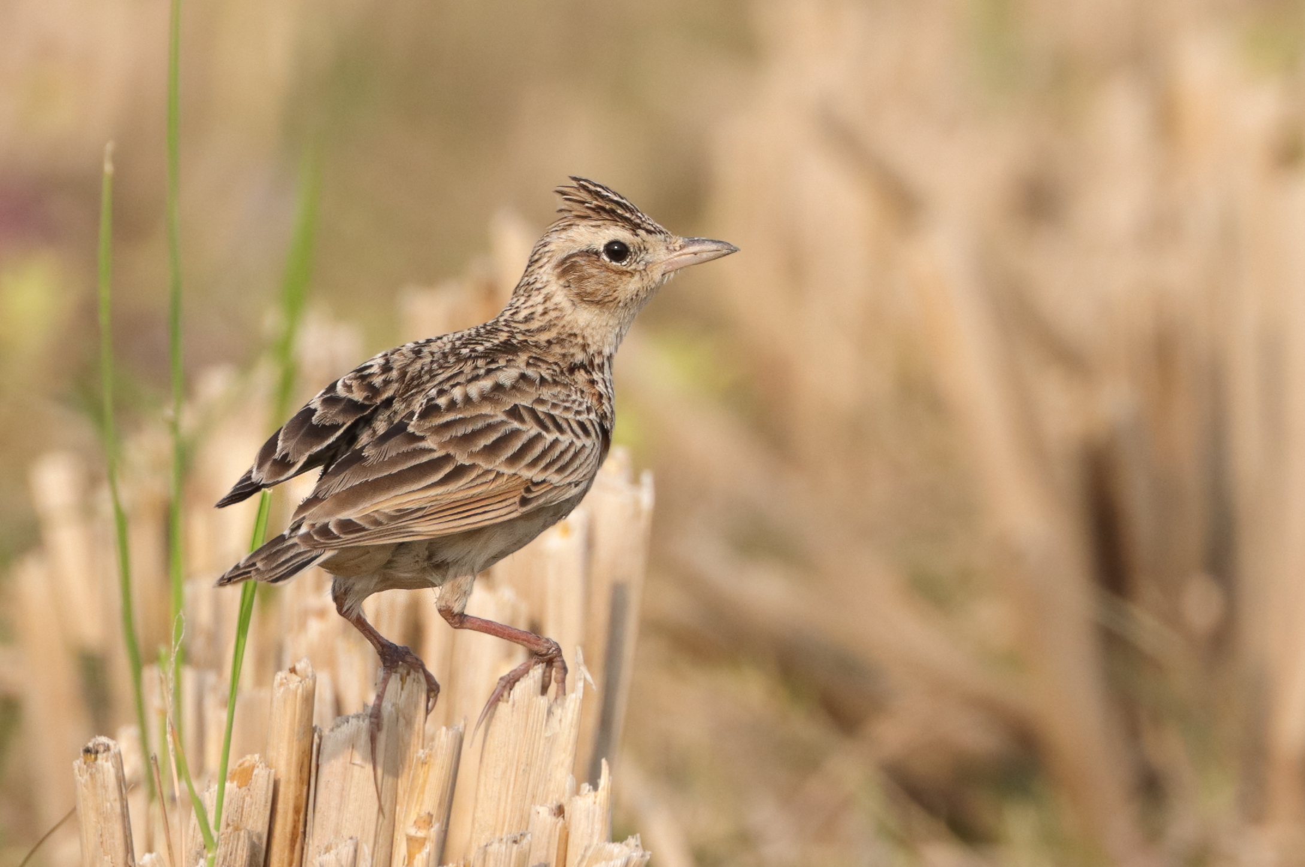
Food Chains
Here is just ONE food chain that happens in the Peak District
Gail Hampshire¹
TAREQ'S PHOTOGRAPHY³
Bilberry
Crane fly
Skylark
Merlin
Can you name the Producer and Consumers in this Food Chain?
Can you name the Predators and Prey in this Food Chain?

Slide 8
Food Chains
Lots of factors can affect animal numbers. In a food chain, changes in numbers of one animal or plant affect the others.
Gail Hampshire¹
TAREQ'S PHOTOGRAPHY³
Bilberry
Crane fly
Skylark
Merlin
What might cause the numbers of plants or animals to change?

Slide 9
Merlin
In recent years, the numbers of merlin have declined.
This is due to a variety of reasons such as habitat loss, human disturbance and hunting by humans.
Gail Hampshire¹
TAREQ'S PHOTOGRAPHY³
Bilberry
Crane fly
Skylark
Merlin

Slide 10
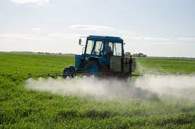

Pesticides
One big factor that affected merlin numbers was the pesticides being used on farms to kill insects eating the crops.
Watch this video to find out more:
(887) Do we really need pesticides? - Fernan Pérez-Gálvez – YouTube
Pesticides can kill the insects that the merlins eat.
Aqua Mechanical¹
Gail Hampshire¹

Slide 11
Food Chains
What will happen to the numbers of bilberry, skylark and merlin,
if there are fewer insects?
Gail Hampshire¹
TAREQ'S PHOTOGRAPHY³
Bilberry
Crane fly
Skylark
Merlin

Slide 12
Food Chains
Merlin numbers are starting to increase again, as the most damaging pesticides are now banned and people are working to protect the merlin and its habitat
Gail Hampshire¹
TAREQ'S PHOTOGRAPHY³
Bilberry
Crane fly
Skylark
Merlin

Slide 13
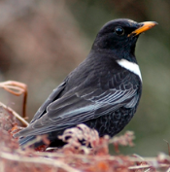
Food Chains
Squeezyboy
Decaying Leaves
Earthworm
Ring Ouzel
Merlin
What will happen to the numbers of bilberry, skylark and crane flies if the number of merlin increases?
Gail Hampshire¹
TAREQ'S PHOTOGRAPHY³
Bilberry
Crane fly
Skylark
Merlin

Slide 14

Food Chains – Activity 1
Have a go of making your own Peak District food chains!
Myhill.bob³
Airwolfhound
Squeezyboy¹

Slide 15
Peak District Wildlife
The Peak District is a very diverse place full of different types of plants and animals.
The plants and animal all depend on each other and their habitat to survive.
See how many animals and plants you can spot around your home and school. Can you create food chains which include these animals and plants?

Slide 16
Image Permissions
  Photo licencing
    If no reference given the Peak District owns or has full permission to use the image
    If referenced and followed by ¹ the following Creative commons license applies: Creative Commons — Attribution 2.0 Generic — CC BY 2.0
    If referenced and followed by ² the following Creative commons license applies: Creative Commons — Attribution-NonCommercial 2.0 Generic — CC BY-NC 2.0
    If referenced and followed by ³ the following Creative commons license applies: Creative Commons — Attribution-ShareAlike 4.0 International — CC BY-SA 4.0

