Slide 1
Rocks and soils: What’s the connection?

Slide 2
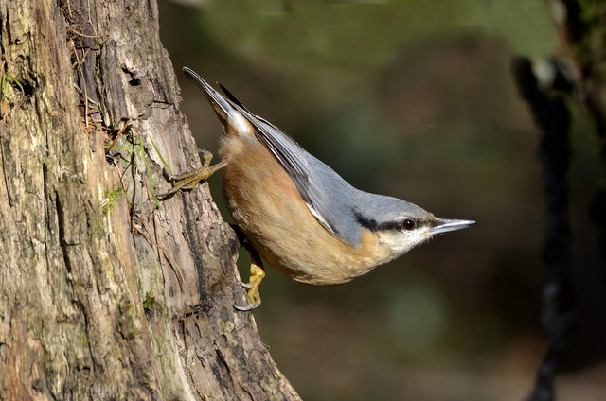
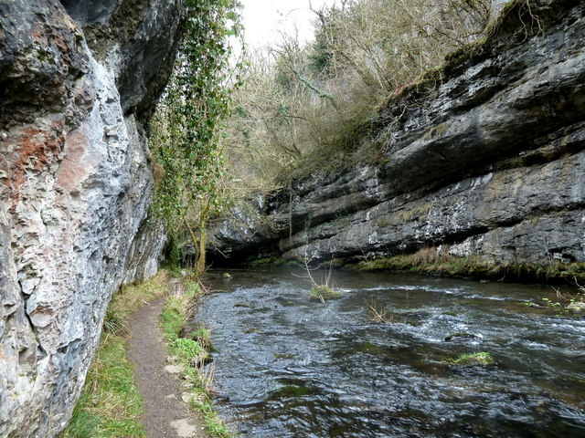
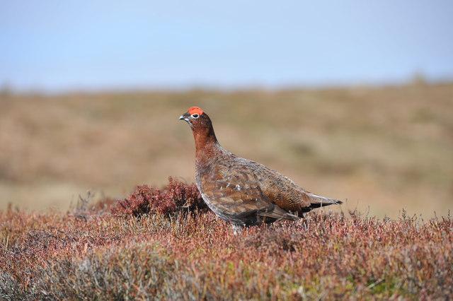
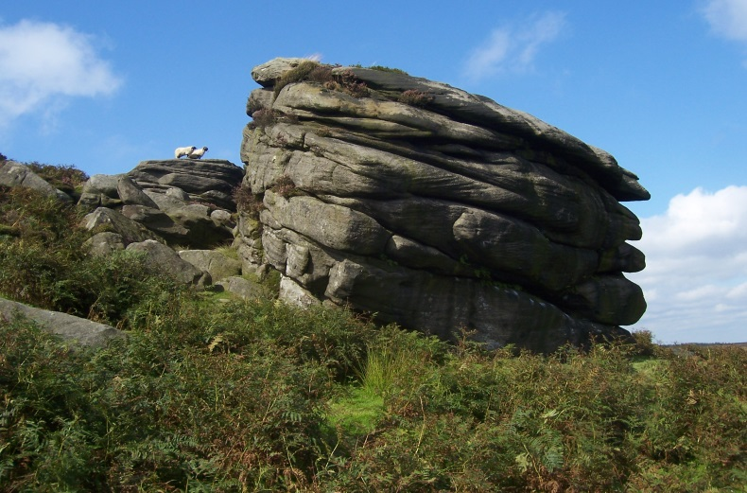
What’s the connection?

Slide 3
Which image shows the Peak District?

Slide 4
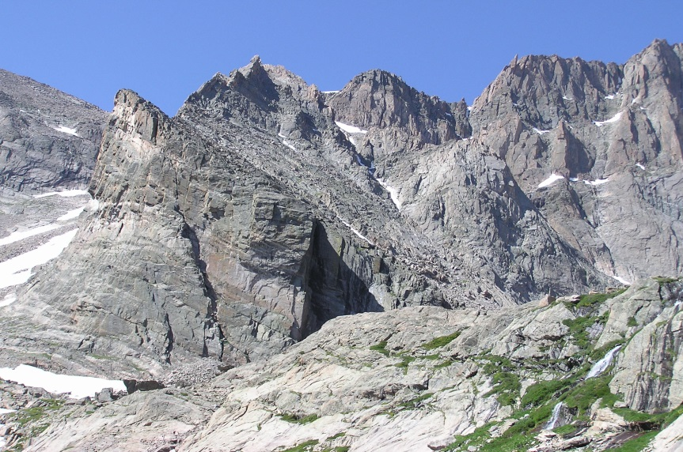
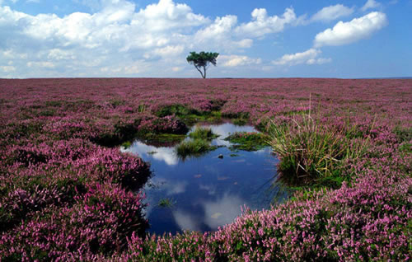
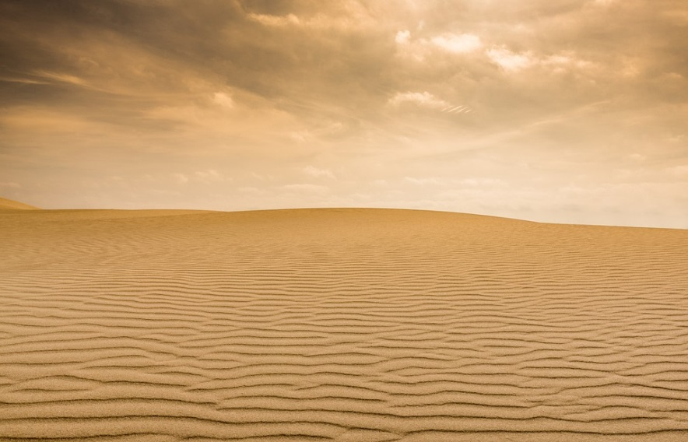
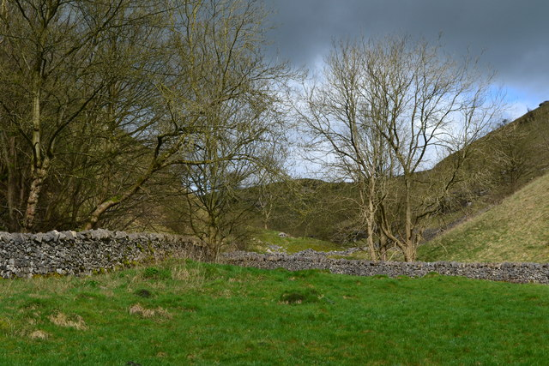
Notes:
How are these landscapes different?
Why are these landscapes different?
Which image shows the Peak District?

Slide 6
The Dark Peak

Slide 7
The Dark Peak
The White Peak

Slide 8
Which animals live in the White Peak?
Which animals live in the Dark Peak?

Slide 9
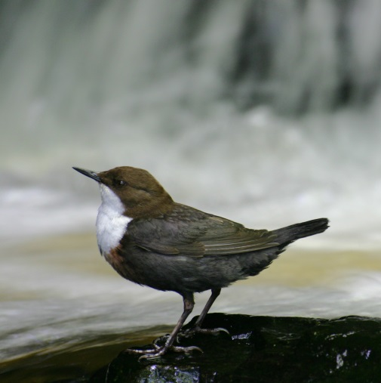
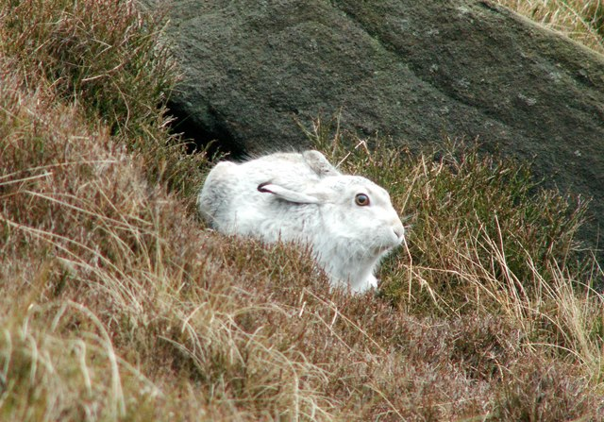
Dipper
Red grouse
Nuthatch
Mountain Hare
Notes:
Water vole and Nuthatch in the White Peak.
Red Grouse and Mountain Hare in the Dark Peak.

Slide 10
Dark Peak
Red grouse
Mountain Hare
Notes:
Water vole and Nuthatch in the White Peak.
Red Grouse and Mountain Hare in the Dark Peak.

Slide 11
White Peak
Dipper
Nuthatch
Notes:
Water vole and Nuthatch in the White Peak.
Red Grouse and Mountain Hare in the Dark Peak.

Slide 12
What’s the connection?
Nuthatch
White Peak
Red grouse
Dark Peak

Slide 13
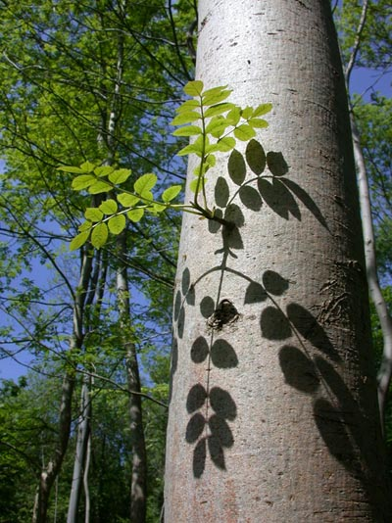
Nuthatches nest in ash trees.

Slide 14
Nuthatches nest in ash trees.
Ash trees can grow in ALKALINE soil.

Slide 15
Nuthatches nest in ash trees.
Ash trees can grow in ALKALINE soil.
LIMESTONE produces alkaline soil.

Slide 16
Red Grouse eat heather seeds.

Slide 17
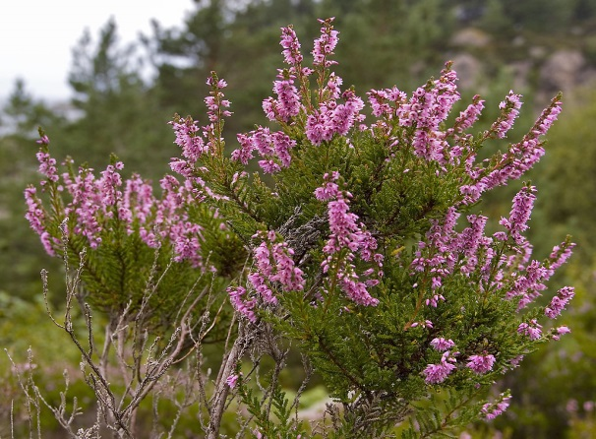
Red Grouse eat heather seeds.
Heather needs ACID soil.

Slide 18
Red Grouse eat heather seeds.
Heather needs ACID soil.
GRITSTONE produces acid soil.

Slide 19
The rock determines the type of soil.

Slide 20
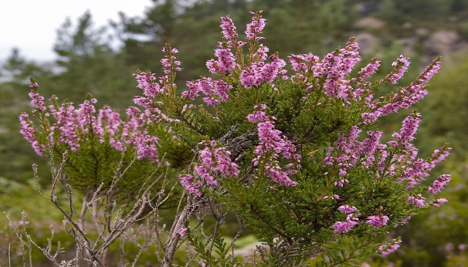
The rock determines the type of soil.
The soil determines the plants that grow on it.

Slide 21
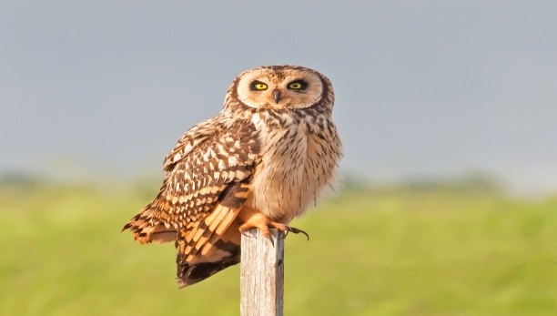
The rock determines the type of soil.
The soil determines the plants that grow on it.
The plants determine the animals that live there.

