Slide 1
The Peak District National Park
Carina Humberstone – Youth Development Officer

Slide 2


This year, 2019, is the Year of Green Action. It is part of the government’s 25 year environment plan. The hope is that people will take opportunities to connect to, enhance and protect the environment.
It is also the 70th anniversary of the National Parks and Access to the Countryside Act. This Act came about because of the action that the general population took, to gain access to our wild spaces and to ensure they are protected.

Slide 3
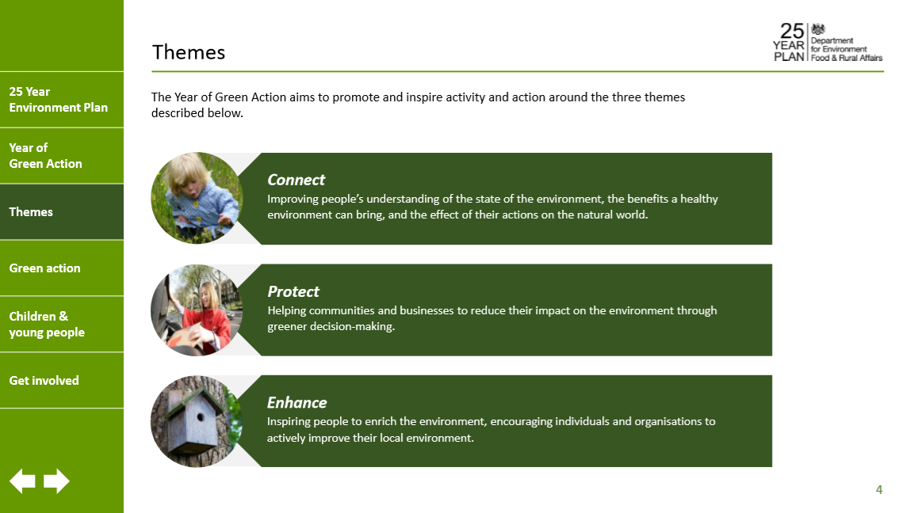

Slide 4
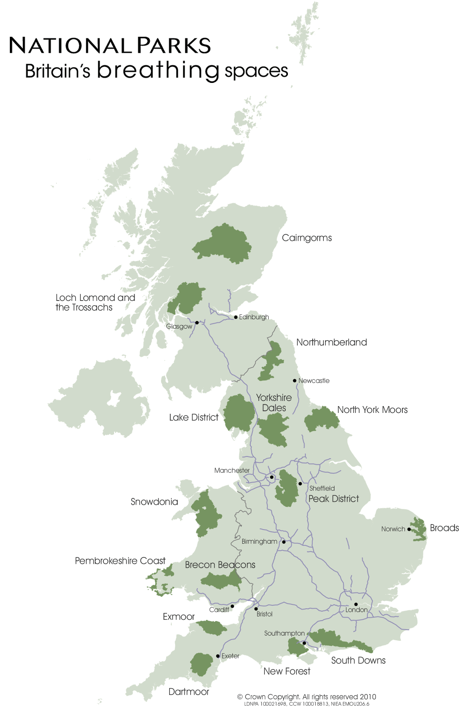
Notes:
What does a NP mean to you?
Does anyone know of a National Park in the UK?
Have a look at where they are. Most of them are quite close to cities and main roads but not in or on them. Why do you think that is? Wild, natural areas. But there are wild, natural areas all over Scotland but not many National Parks. Why do you think that is?

Slide 5
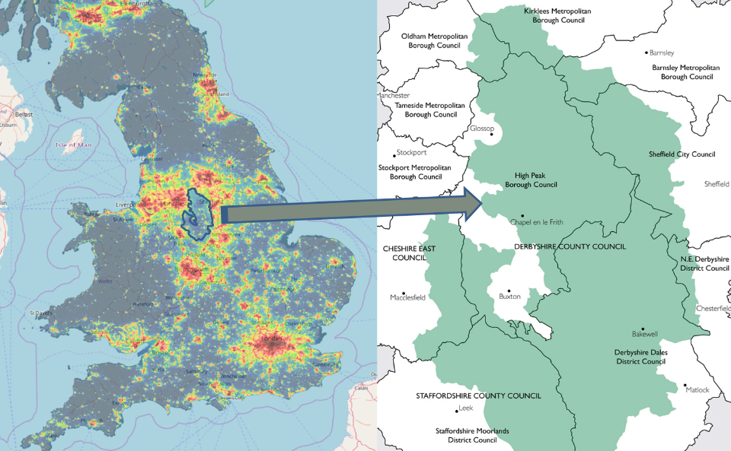
Notes:
What about if I tell you that the first purpose of UK National Parks is to conserve and enhance the natural beauty, wildlife and cultural heritage; what (who) do you think we are protecting them from? Someone once said, if there were no people we wouldn’t need National Parks.
This slide shows the Peak District National Park at night. What do you think the orange and red spots are?

Slide 6
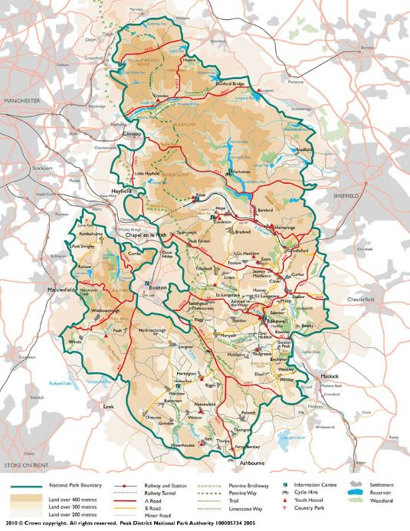
Mark, or point on the map, where your base is. Add how many minutes drive you are from the PDNP in the notes, then delete this box.
Notes:
This slide shows the Peak District National Park and Alfreton. Does anyone know how long it takes to drive into the NP from here? … minutes. How close are we? Can you see the grey areas of the cities around the Park? Who enjoys being outside? What do you think & feel when you’re outside? Is being outside good for us?

Slide 7
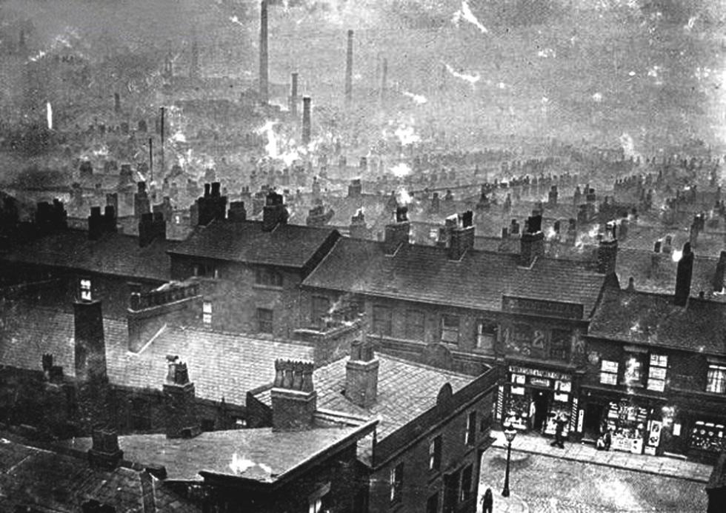
Notes:
What do you think when you see this picture?

Slide 8
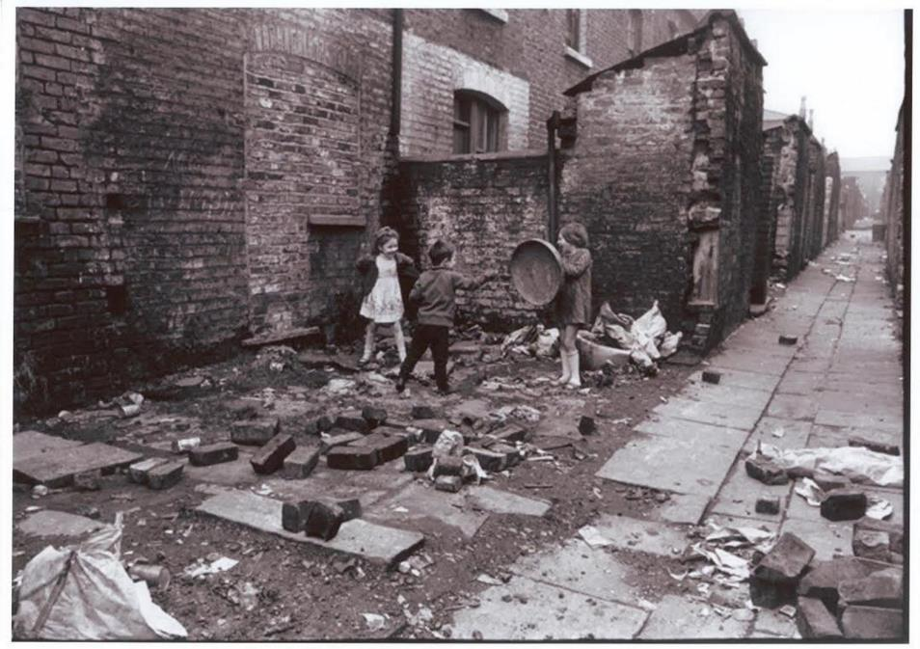
Notes:
And this one? Imagine those children are you.

Slide 9
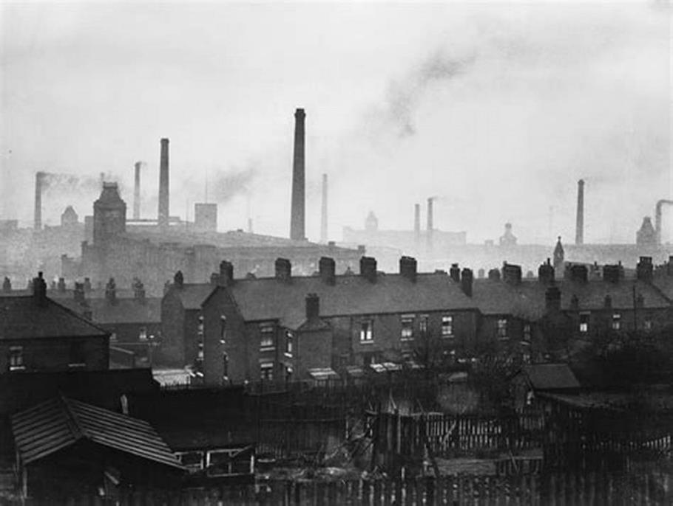
Notes:
And this one? Dirty, smoky, cramped. The majority of the population lived in large towns and cities, working 6 days a week in difficult conditions and living in small houses in smoke-filled towns. At the same time wealthy landowners were closing off their land to use it for sport and farming. Access to the countryside was being restricted just when the population needed it most. After the First World War people really began to see the benefits of the countryside for both body and mind but most of the people weren’t allowed into it.

Slide 10
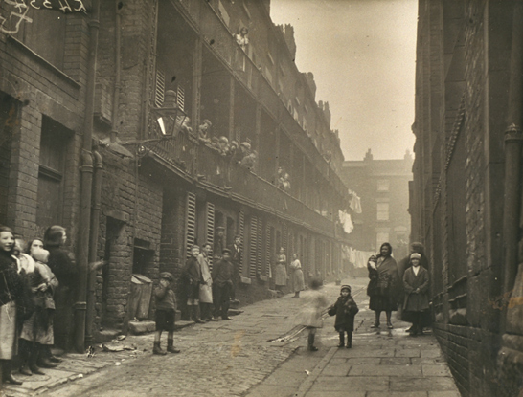
Notes:
What do you think these children would do in the countryside? How do you think they would feel?

Slide 11
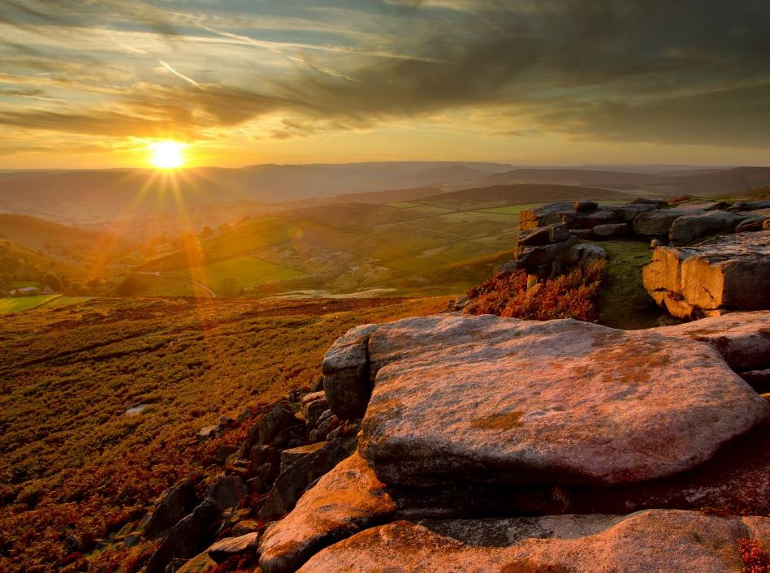
Notes:
This is what they were missing. It is not just the amazing views and lovely landscape, but the benefits it can bring. All those people were being denied access to this, so they decided to act.

Slide 12
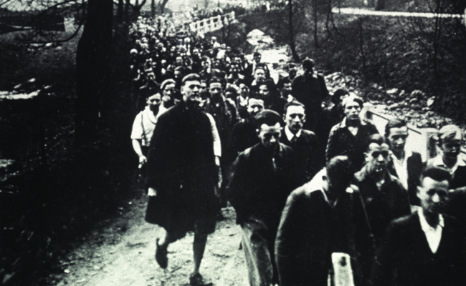
Notes:
There were many conflicts between landowners and groups that wanted access to the countryside such as The Ramblers Association and the Youth Hostel Association. In 1932 a large group of people came together, mainly from Manchester, but also Sheffield and they trespassed on some of this private land. The land in question is Kinder Scout, in the PDNP. Some of the trespassers were put in prison. People started to take notice and in 1949 an Act was passed by the government ‘The National Parks and Access to the Countryside Act’. This was the beginning of National Parks in the UK. The Parks were protected and everyone was allowed to visit, in fact they are encouraged to.

Slide 13
Play Video – The Peak District.mp4
Notes:
What is the first purpose of a UK national Park?
Does anyone want to guess what the 2nd purpose is? To promote opportunities for the understanding and enjoyment of the special qualities of the area by the public. This means we want people to come to the National Parks and enjoy them. Why do you think that is?
Show the video. This is the PDNP. It is pretty special isn’t it? So we want people to come and enjoy it. There is no point keeping it secret. If people come and enjoy it, they might think it is special too and help us to look after it.

Slide 14
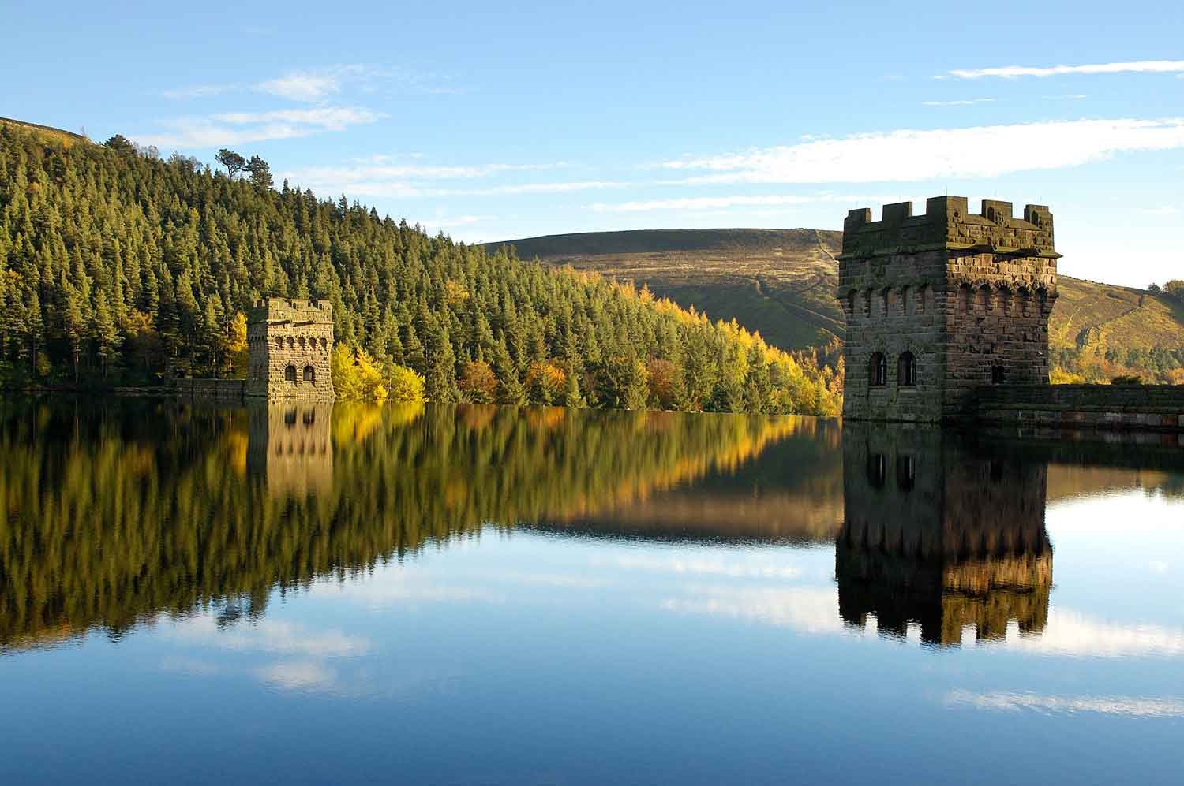
Notes:
This is in the Peak District National Park. What do you think? These dams have created reservoirs that supply water to cities outside of the National Park such as Derby, Nottingham and Manchester. The air and water are really clean.

Slide 15
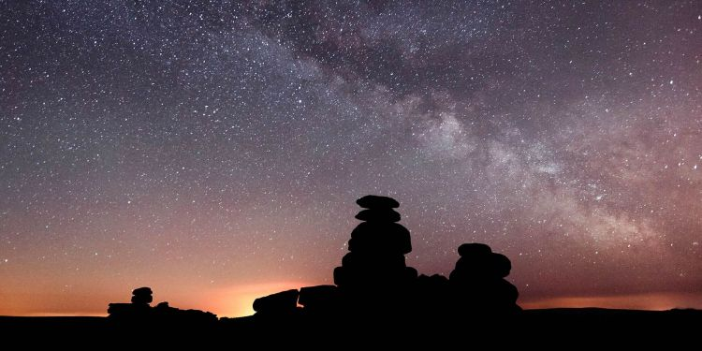
Notes:
Remember the slide showing the light pollution and how there wasn’t any in the National Park? That means you get a great view of the stars and planets.

Slide 16
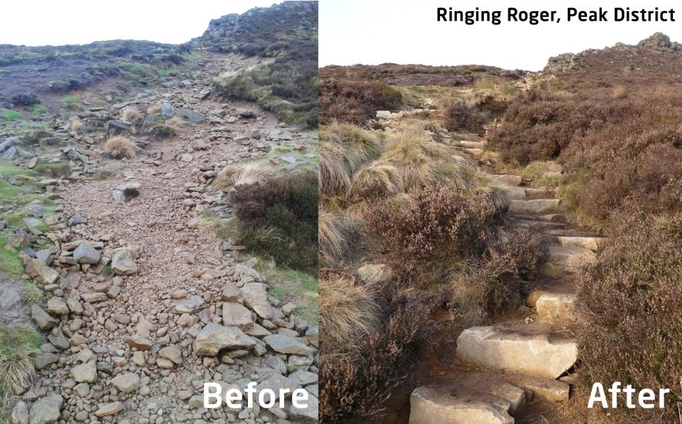
Notes:
Today we look after the National Park and promote opportunities for people to enjoy the Park. What do you think we are doing to look after it and why? Are these things helping people enjoy it and making it easier for them to visit?

Slide 17
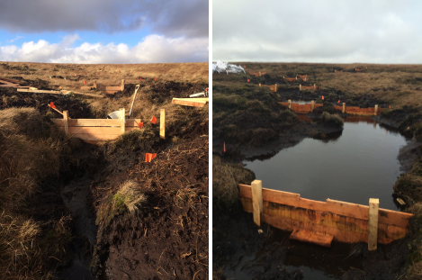
Notes:
This is Peat found on the top of some of our hills. It is very important to help combat global warming as it stores carbon. We are working to stop the peat getting washed away, so it can continue to fight against global warming.

Slide 18
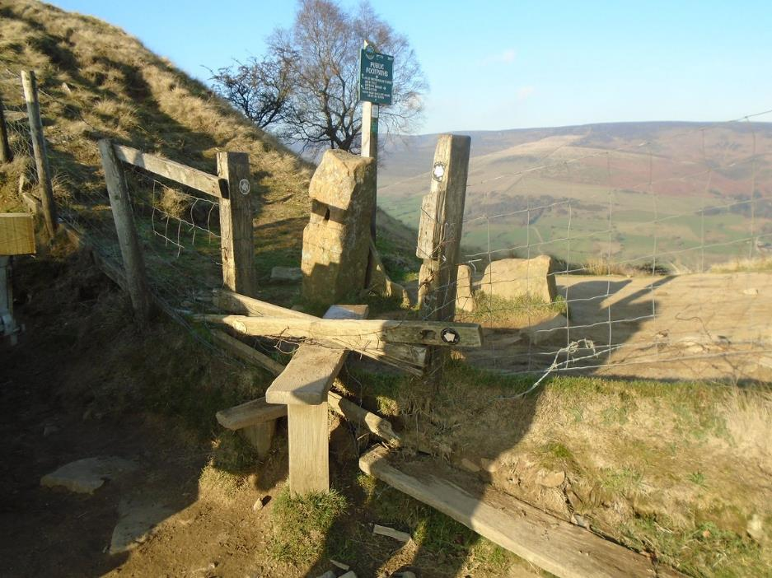
Notes:
This stile and fence will be mended by our rangers and volunteers. How does this help people enjoy and visit the National Park?

Slide 19
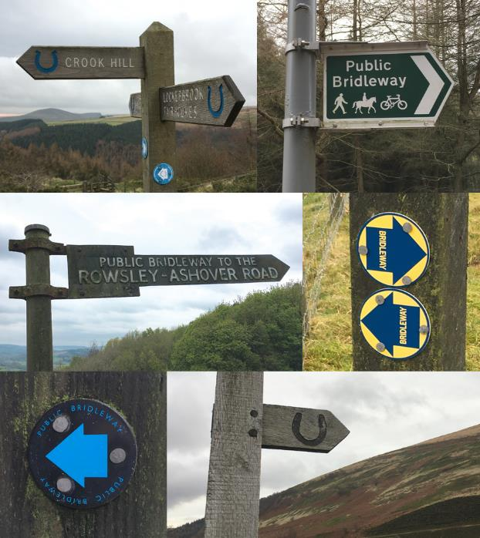
Notes:
How do these help visitors?

Slide 20
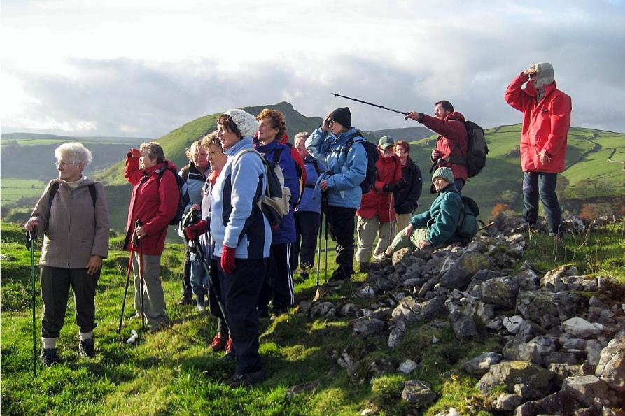
Notes:
Rangers and volunteers lead guided walks. Some people don’t feel confident to come to the Park on their own; others just want to learn more about it from the experts.

Slide 21
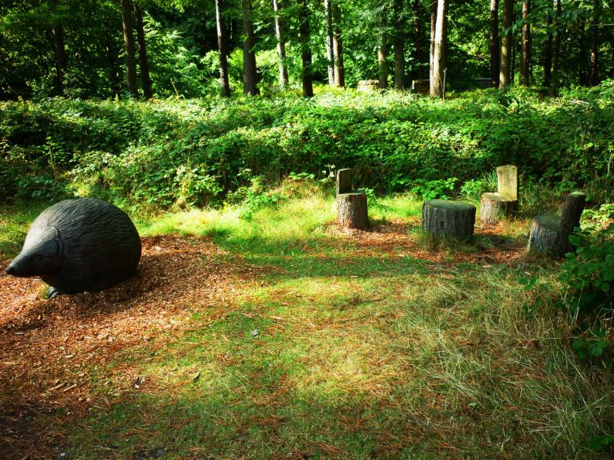
Notes:
This is really close to one of our car parks and visitor centres. Some people don’t go far from their cars when they visit.

Slide 22
Put a picture in here of a local, outdoor space. Maybe your local park. Then delete this box.
Notes:
We talked earlier about the benefits of being outside. We talked about the benefits of being outside. Do you have to be in a NP to get the benefits? What about in these spaces?

Slide 23
Insert a picture of your grounds, particularly of a wild space. Then delete this box.
Notes:
Or this one? What is special about them? How can you conserve and enhance them?

Slide 24
Insert a picture of your grounds, particularly of a wild space. Then delete this box.
Notes:
Or encourage people to enjoy them?

Slide 25
Insert a picture of your grounds, particularly of a wild space. Then delete this box.

Slide 26
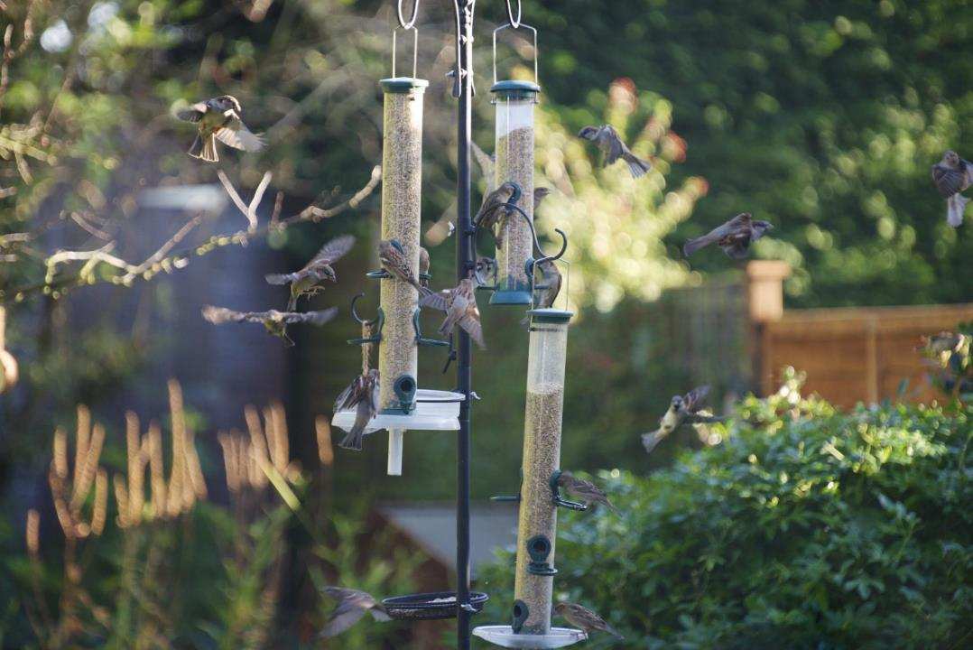
Notes:
I’m partly here to encourage you to look after your special outdoor spaces. What do you think these slides are suggesting that you do?

Slide 27

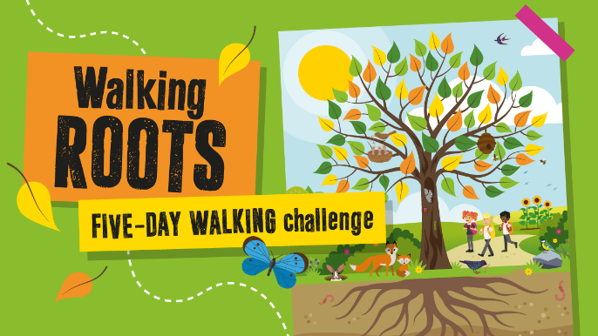
Act now to save children from pollution
https://www.livingstreets.org.uk/what-we-do/projects/walk-to-school-week

Slide 28



Slide 29
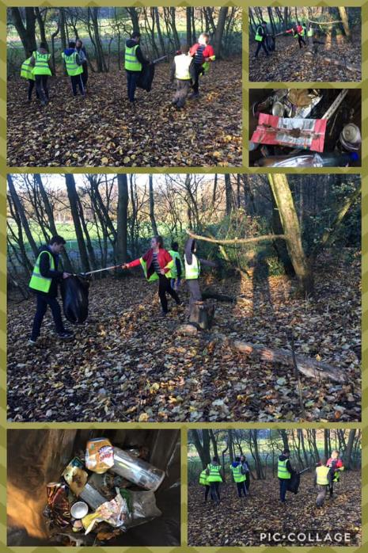
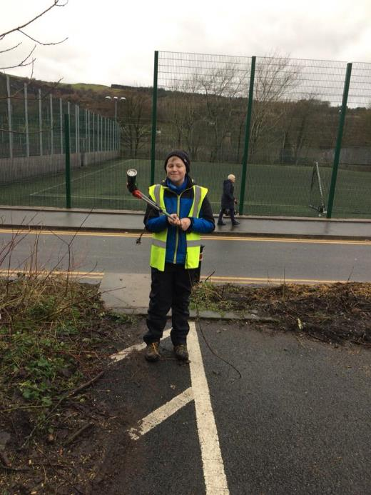

Slide 30
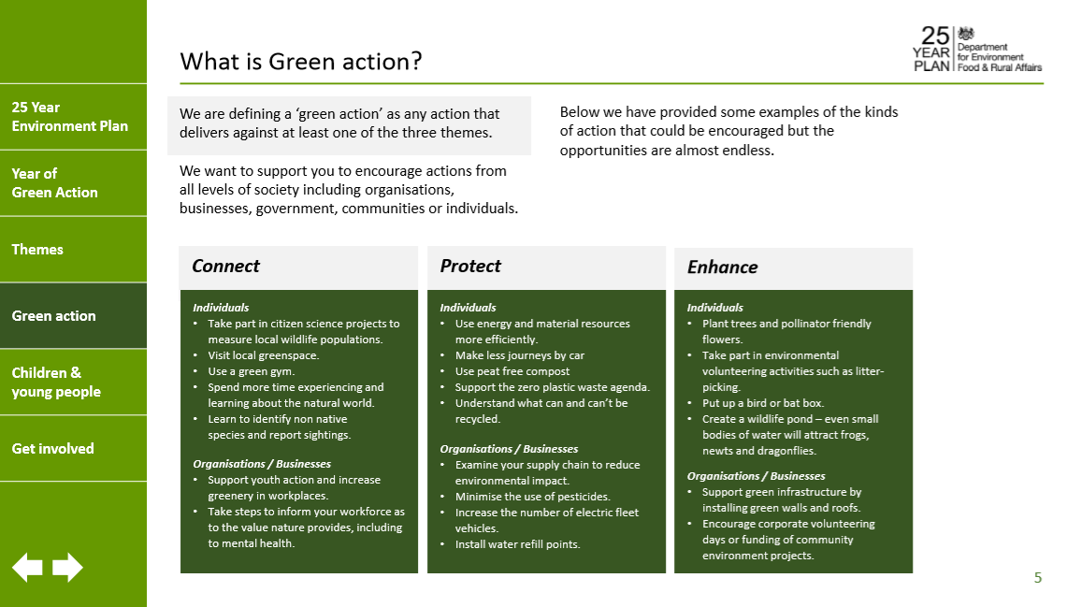
Notes:
What action will you take ibn 2019 to ensure that our wild spaces continue to be protected?

Slide 31
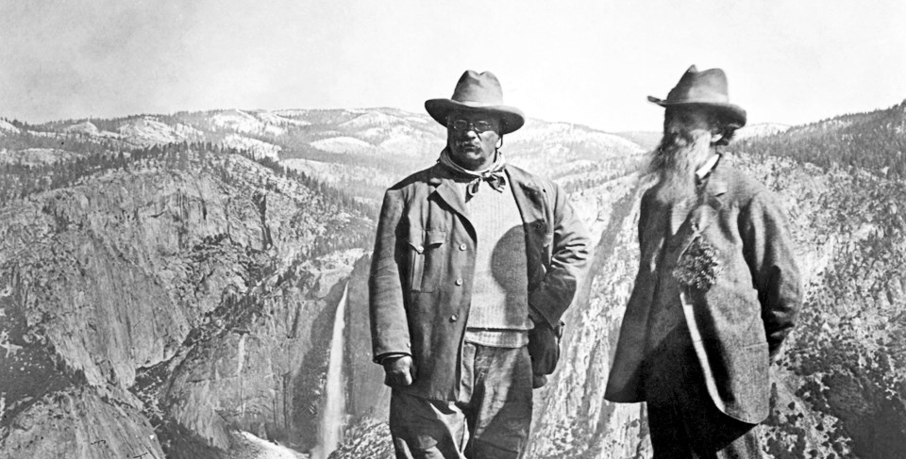
If you will be doing the John Muir Award, keep these next slides in & delete this box.
John Muir was born in 1838 in Dunbar, Scotland. He loved exploring the outdoors and was passionate about nature. In 1949 his family moved to the USA. Here he was seen as the founder of the modern conservation movement. Although National Parks were already established in the USA Muir changed the way they worked, to ensure conservation was at the heart. He even took the president Teddy Roosevelt camping.
Notes:
Going back to our history and including a bit of Geography. It is 1849 and we’re now going across the Atlantic Ocean to what big country? We’ve travelled across with a boy, a little older than you, 11 years old. He was born in Scotland and he loved nothing more than having fun outdoors. He loved the outdoors so much, and realised how special it was that when he was older he helped to set up National Parks to protect the landscape in the USA, long before they were set up here. He even went camping with the president at the time Theodore Roosevelt.

Slide 32
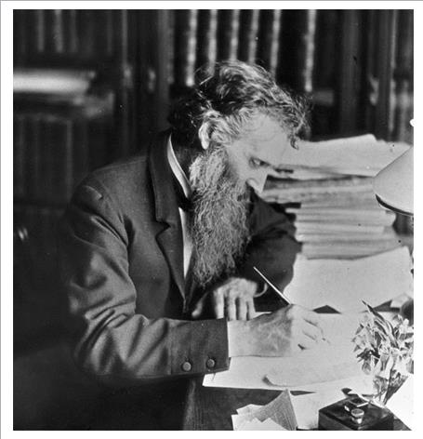
John Muir loved playing outside. He felt at one with nature. He did some crazy things such as tying himself to the top of a tree in a storm.
He didn’t really like writing but as he travelled so far, and learnt so much, he was encouraged to share what he had seen and learnt. From sharing his experiences he ahs inspired thousands of people to enjoy, and to care for the environment.
Notes:
This man is John Muir, often known as the father of National Parks. His work is celebrated and people all over the world are following in his footsteps by exploring the great outdoors and doing something positive to conserve it, just like we do here, in the PDNP. Your teacher tells me that you will be undertaking a John Muir Award, spending time discovering, exploring and conserving your chosen wild spaces. You might even come to visit the PDNP. What would you like to see in the Peak District National Park?

Slide 33
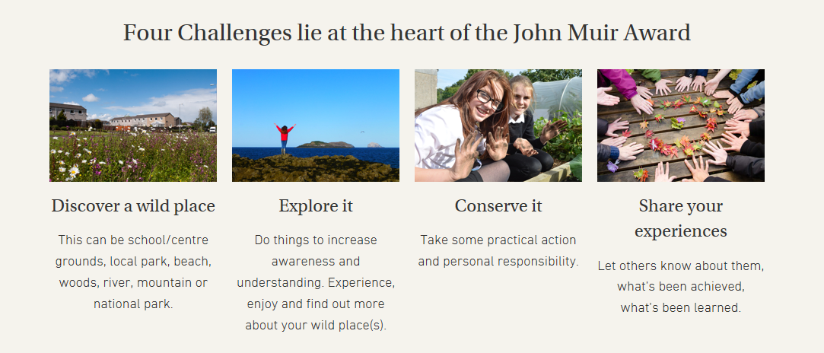


Slide 34

Notes:
This year is a great time to do something. It is the Year of Green Action and the 70th Anniversary of the National Parks and Access to the Countryside Act. There is still so much to do, to protect our wild spaces and the creatures that call these places home. So, like those people 70 or so years ago, what action are you going to take to ensure we protect our wild spaces?

Slide 35
The mountains are calling. I must go…..
Notes:
Well, to quote John Muir himself…. I have spent too long indoors today….

