Slide 1
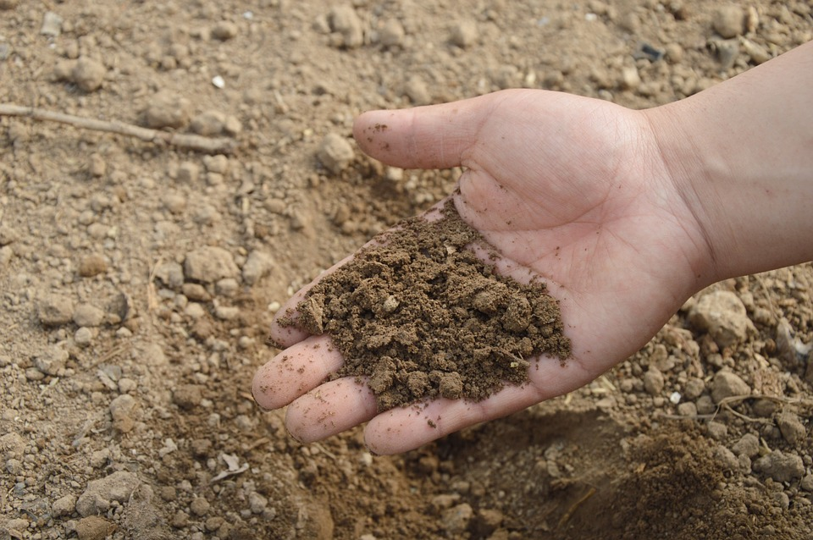
What’s so special about soils?????

Slide 2
Why is soil important?

Slide 3
PLANTS grow in soil. If there was no soil, there would be no plants and NO FOOD!!!
Why is soil important?

Slide 4
PLANTS grow in soil. If there was no soil, there would be no plants and NO FOOD!!!
Some soils hold a lot of WATER. If there was no soil,
this water could flood towns and cities.
Why is soil important?

Slide 5
PLANTS grow in soil. If there was no soil, there would be no plants and NO FOOD!!!
Some soils hold a lot of WATER. If there was no soil,
this water could flood towns and cities.
Why is soil important?
Some soils hold a lot of CARBON which stops GLOBAL WARMING.

Slide 6
PLANTS grow in soil. If there was no soil, there would be no plants and NO FOOD!!!
Some soils hold a lot of WATER. If there was no soil,
this water could flood towns and cities.
Why is soil important?
Some soils hold a lot of CARBON which stops GLOBAL WARMING.
Soils are a HABITAT for many organisms – worms, insects and bacteria.

Slide 7
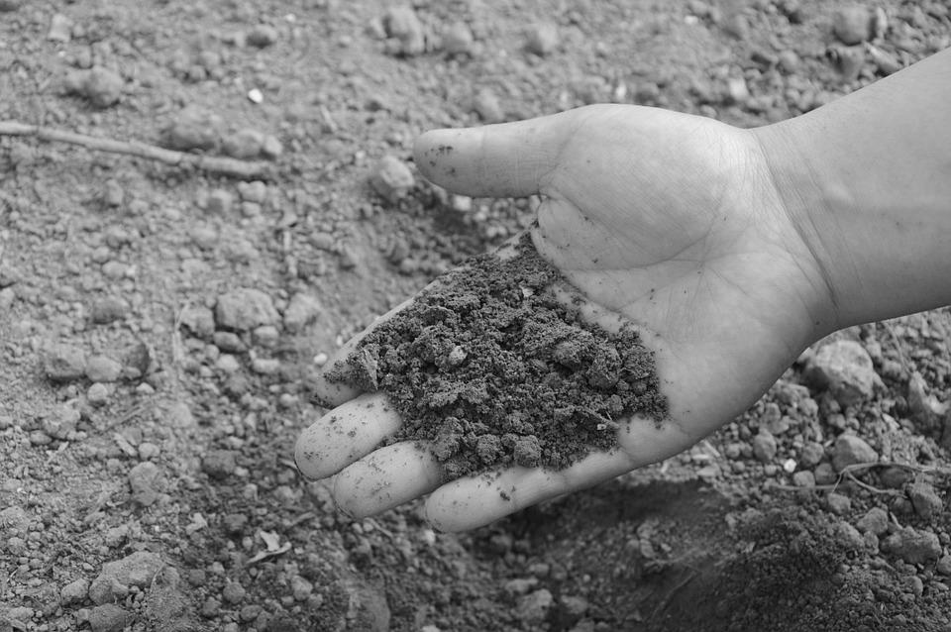
What is soil made from?

Slide 8
What is soil made from?
Carefully observe your soil and record what you see.

Slide 9
Organic material
(humus) :
Plants and animals – DEAD OR ALIVE!
What is soil made from?

Slide 10
Organic material (humus)
Plants and animals – DEAD OR ALIVE!
Inorganic (never been alive) material:
Rock fragments, water and air.
What is soil made from?

Slide 11
Is all soil the same?

Slide 12
Is all soil the same?
(Time to get your hands dirty!)

Slide 13
Clay soils can be very sticky when wet and very hard when dry.
Is all soil the same?

Slide 14
Clay soils can be very sticky when wet and very hard when dry.
Is all soil the same?
Sandy soils are light and low in nutrients.

Slide 15
Clay soils can be very sticky when wet and very hard when dry.
Is all soil the same?
Peat holds a lot of water and plant remains which contain carbon. They are very acidic.
Sandy soils are light and low in nutrients.

Slide 16
Clay soils can be very sticky when wet and very hard when dry.
Chalky soil is low in nutrients and very alkaline – the opposite of acidic.
Is all soil the same?
Peat holds a lot of water and plant remains which contain carbon. They are very acidic.
Sandy soils are light and low in nutrients.

Slide 17
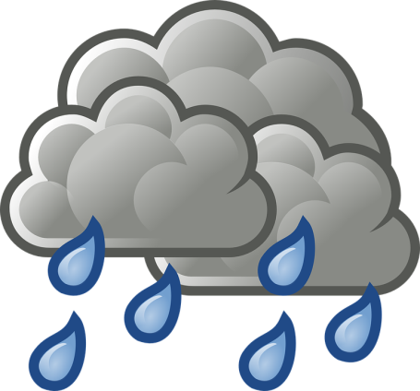
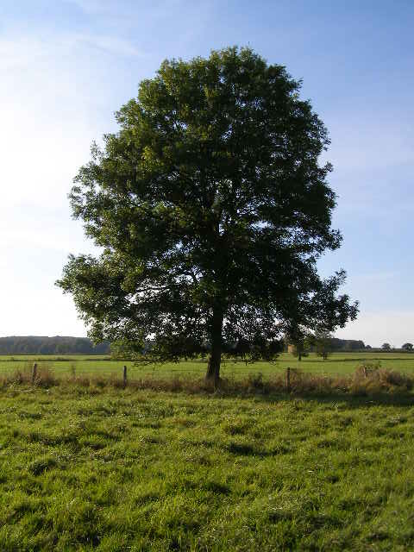
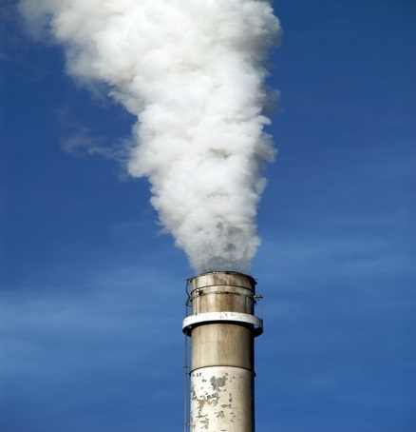
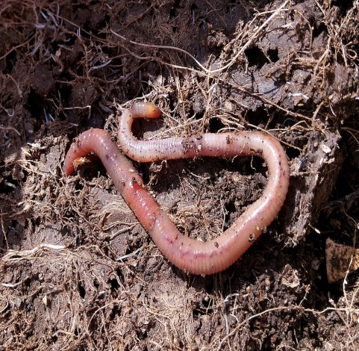
Why is soil important?

Slide 18
Which types of soil do you think you will find on your Peak District visit?

