Slide 1


Peat in the Peak:
Why is peat special?

Slide 2
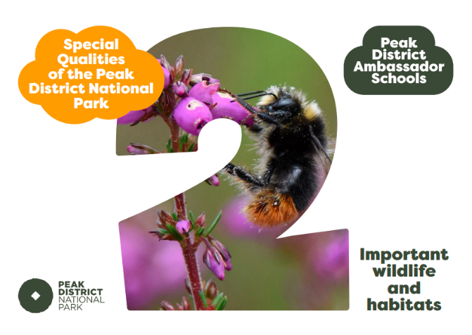
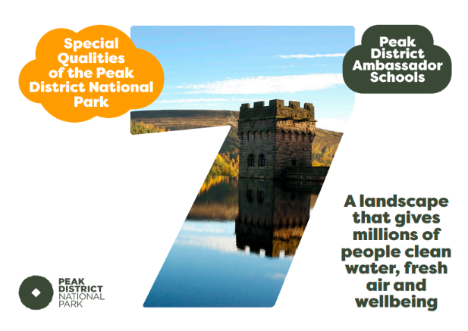

Slide 3
Key Vocabulary
Decompose - to rot or break down into its smaller components
Waterlogged – full of water (saturated)
Degraded – In a bad or broken state
Vegetation – a large group of plants growing together

Slide 4
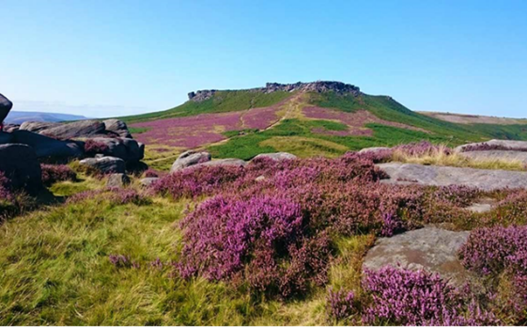
What is peat?
Peat is a rare type of soil and is the main reason our moorland is such a special place.

Slide 5
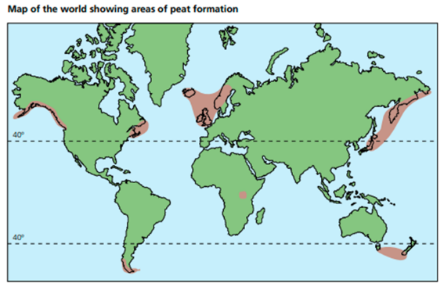
What is peat?
Peat started forming around 7500 years ago when the world was cooler. Now it only forms in the few places shown on this map
Can you name all the places peat is still forming?
Use a world map to help you!
Where are we on the map?

Slide 6
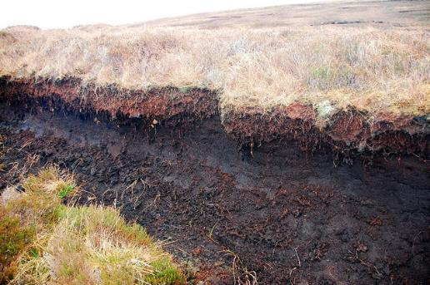
Peat is rare!
Peatland covers just 3% of the world’s surface
In the British Isles, we have 10-15% of the world’s peatlands.
Peat is rarer than tropical rainforest!
Image: Ian Balcombe ²

Slide 7
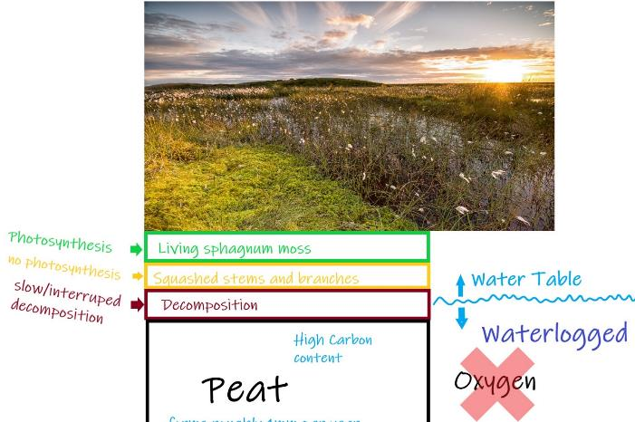
How is peat formed?
Peat only forms at cooler temperatures where the ground is waterlogged
In these places plants can’t decompose fully and instead form peat!
Peat forms at 1mm per year, it’s very slow!
Image: Moors for the Future

Slide 8
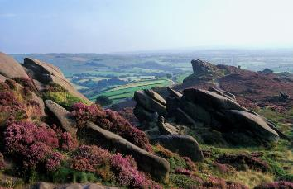
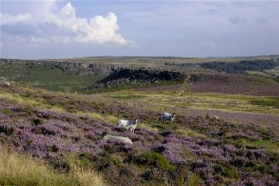
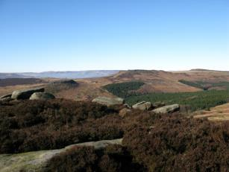
Why are peatlands so special?
The Peak District is a beautiful place and wouldn’t look the same without the peatlands!
There are lots of other reasons that peatlands are special which we can explore on the next few slides…

Slide 9
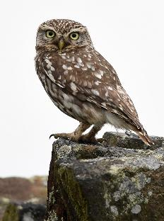
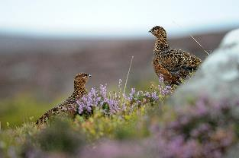
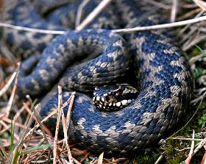
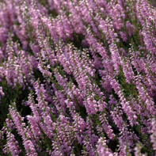
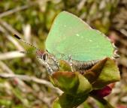
Wildlife
Peatlands are home to lots of special plants and animals

Slide 10
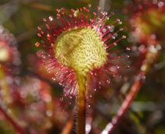
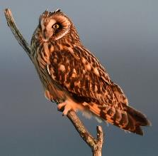
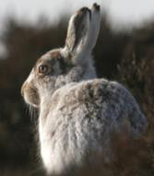
Wildlife on Peatlands
This Sundew plant is a carnivore! It eats insects, and only grows in boggy places (such as on peat soil)
The Peak District is the only place in England you’ll find this Mountain Hare
The Peak District is an important habitat for Short-Eared Owls

Slide 11
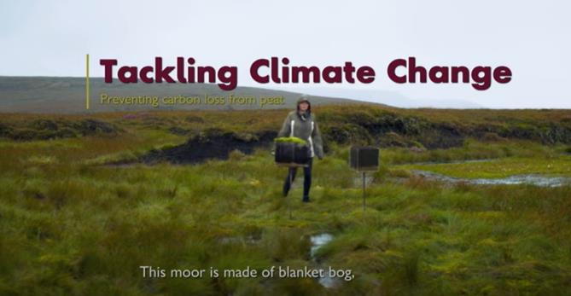
Carbon Sink
Watch this short video from Moors for the Future and answer the following questions:
What % of peat is carbon?
What happens when peat is bare?
Blanket bogs are worth protecting - Tackling climate change - YouTube
Notes:
HOME | Moors for the Future

Slide 12
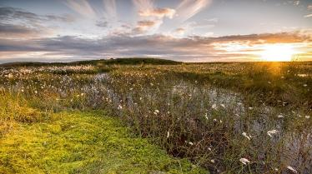
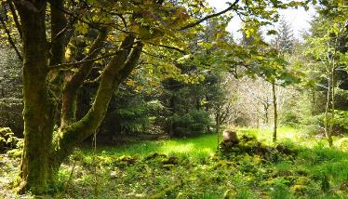
Carbon sink
‘Peatlands are a carbon sink’ – it takes in and stores a large amount of carbon
It is thought that peat bogs in the UK store more carbon than all the forests in the UK, France and Germany combined!
Image: Moors for the Future

Slide 13
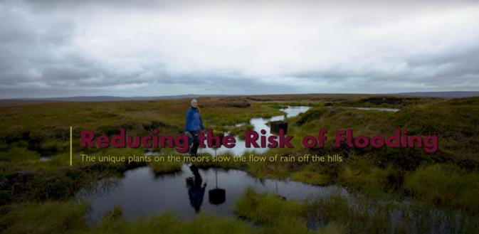
Reduce flooding
Watch this short video from Moors for the Future and answer the following questions:
What can happen when lots of rain comes quickly?
What happens when rain falls on degraded peat?
What happens when rain falls on healthy peat?
Blanket bogs are worth protecting – Reducing the risk of flooding - YouTube

Slide 14
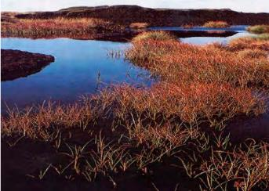
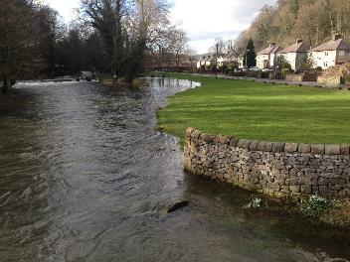
Reduce flooding
Peat bogs are a type of wetland and very important in the water cycle
When peat is healthy, covered with vegetation, it is like a sponge and slows down the flow of water
Peat can help reduce flooding in lowland towns
We want extra water here in the peat bogs!
Not here causing rivers to overflow!
Image: No Copyright

Slide 15
Why is peat special?
Work in Pairs: Give 4 reasons that make peat soil special

Slide 16
Why is peat special?
Work in Pairs: Give 4 reasons that make peat soil special
Peat is a rare type of soil so what is left of it needs protecting
It is home to lots of wildlife, some of which can only be found on peat soil
Healthy peatlands are a carbon sink, storing lots of carbon
Healthy peat helps to reduce flooding in nearby towns

Slide 17
What next?
Fill in the “Why is peat special?” box on the ‘Peat in the Peak’ summary worksheet. You can draw or write
You could do our Spongey Peat and/or Soil and Plants Activities
Look at our next lesson in the ‘Peat in the Peak’ series: Peat in Trouble

Slide 18
Image Permissions
  Photo licencing
    If no reference given the Peak District owns or has full permission to use the image
    If referenced and followed by ¹ the following Creative commons license applies: Creative Commons — Attribution 2.0 Generic — CC BY 2.0
    If referenced and followed by ² the following Creative commons license applies: Creative Commons — Attribution-NonCommercial 2.0 Generic — CC BY-NC 2.0

