Slide 1

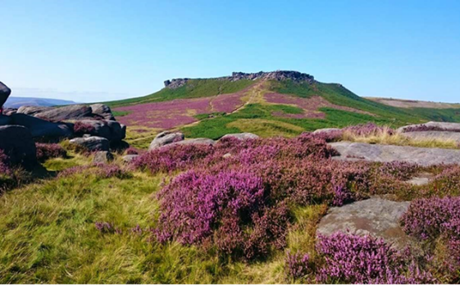
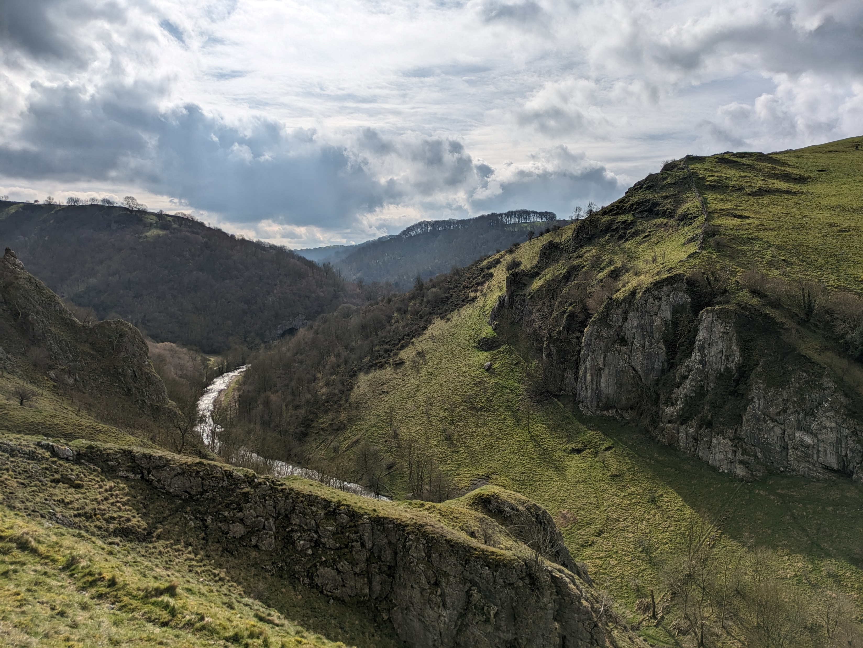

The Geology of the Peak District National Park
How the landscape we see today was made

Slide 2
Key vocabulary
a solid material which is naturally occurring. It can be made of minerals, animal and plant remains, and pieces of other rocks.
the remains of dead creatures and plants which have been preserved in rocks.
movements of the crust (the hard outer layer of the Earth) which form mountains and can cause earthquakes.
Rock
Fossil
Tectonic Movements

Slide 3
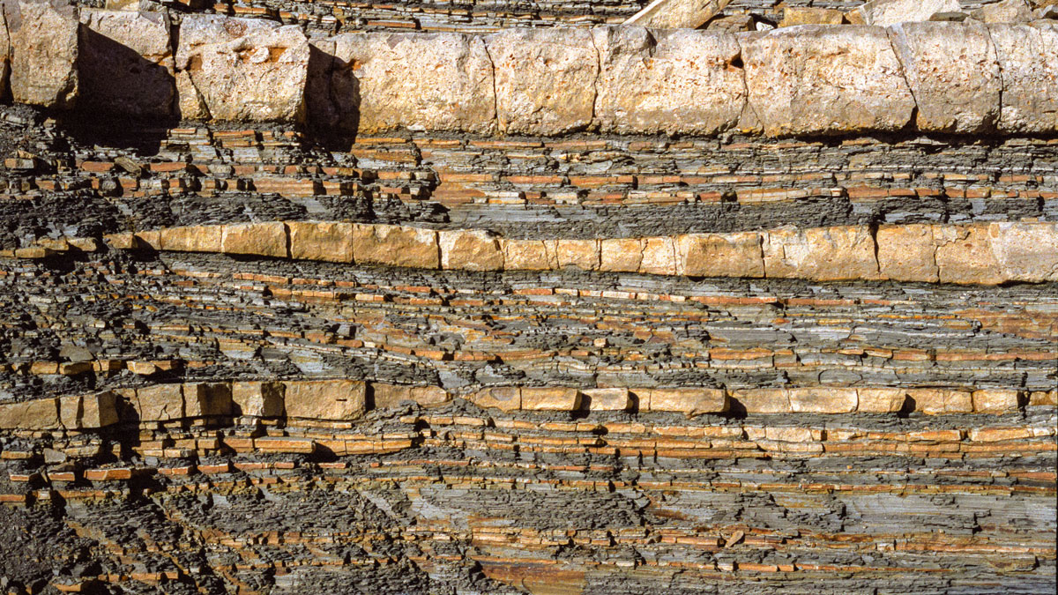
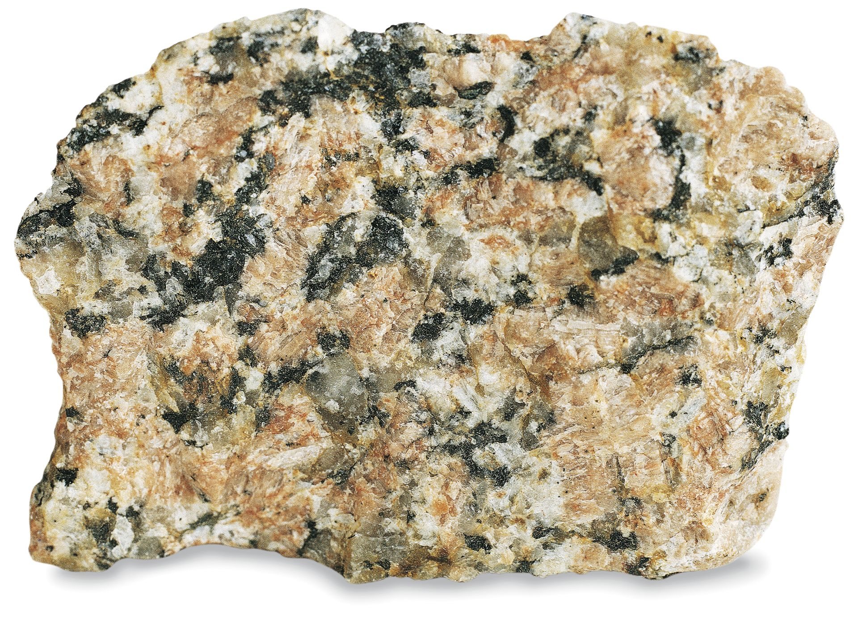
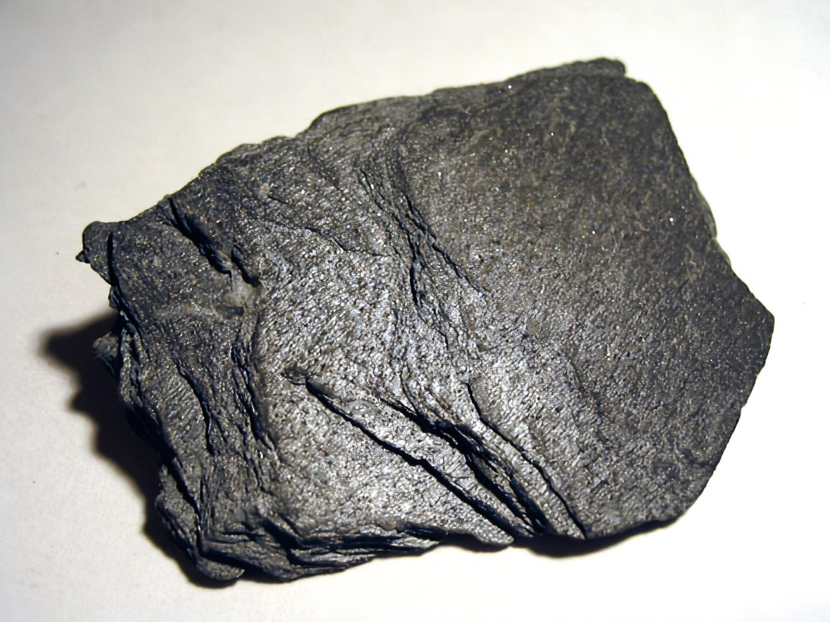
Do you know the three main types of rocks?
Sedimentary
Igneous
Metamorphic

Slide 4
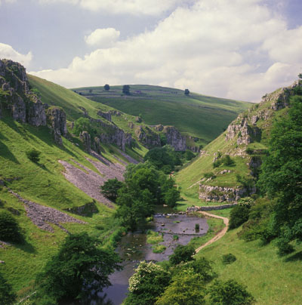
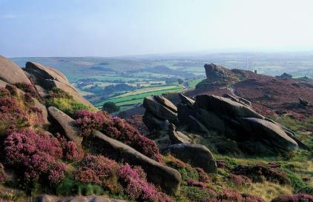
How do we know that there are rocks in the Peak District?
We can see them where they occur naturally at the Earth’s surface. And of course, without them we wouldn’t be standing on anything.

Slide 5
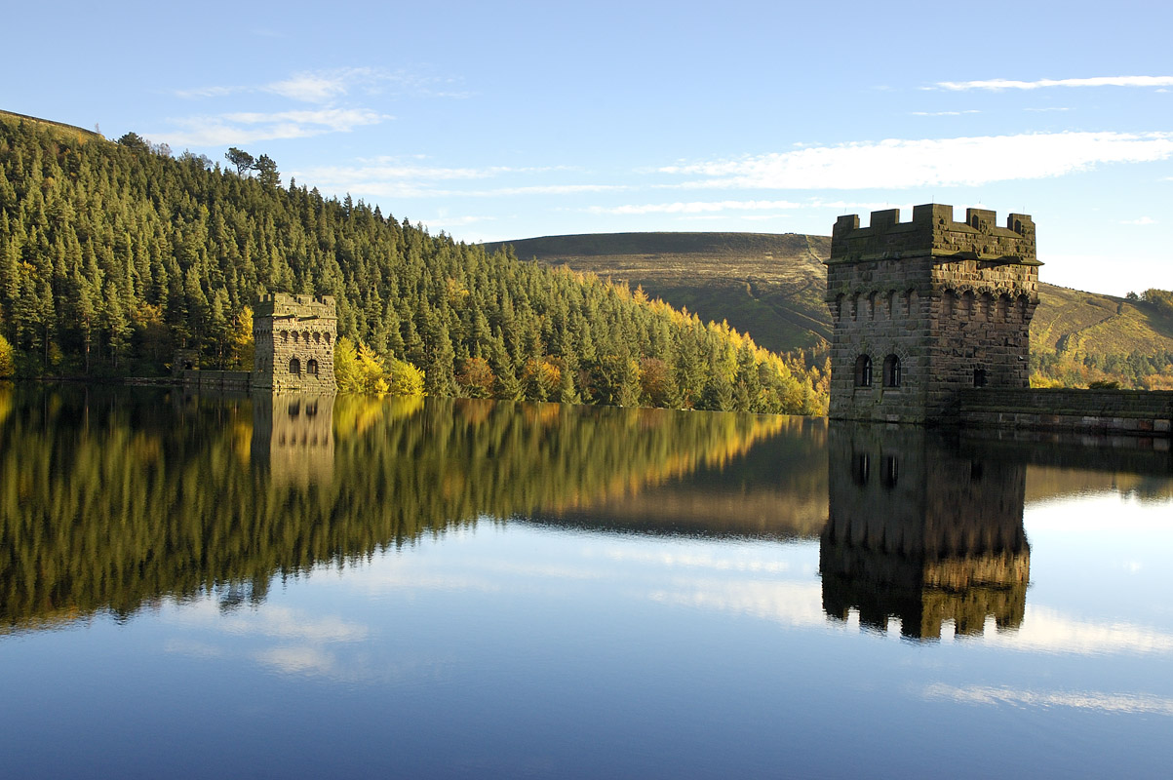
How do we know that there are rocks in the Peak District?
They underpin all of the beautiful views of dramatic landscapes which we see in the National Park.

Slide 6
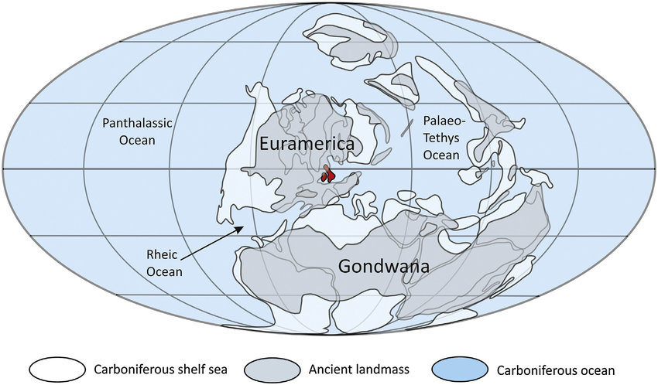
The rocks in the Peak District
Most of the rocks in the Peak District are sedimentary. They were formed between roughly 350 and 300 million years ago when what is now Britain lay close to the equator. During this time, much of what became the Peak District was under water.

Slide 7
Limestones
The limestones of the Peak District are generally white or pale grey. They are the oldest rocks in the Peak District: around 350 – 330 million years old.
Limestone is found in an area of the Peak District called the White Peak.
Can you guess why it is called the White Peak?

Slide 8
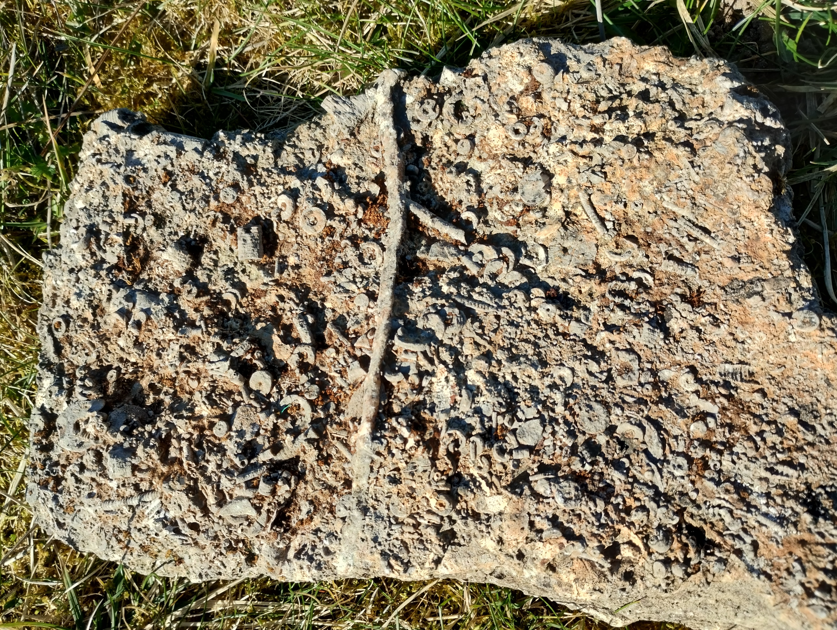
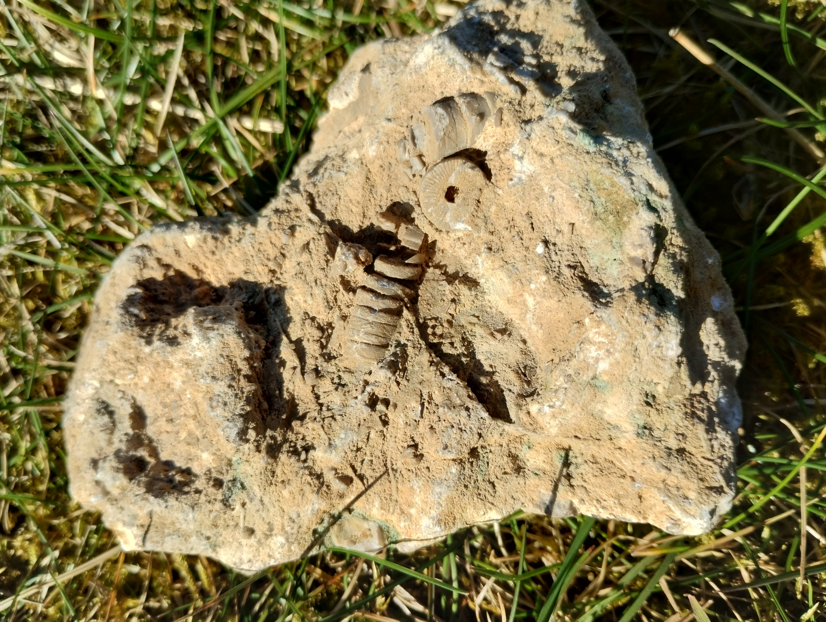
Limestones and fossils
The tropical seas had lots of animals living in them. When they died, their remains settled to the sea floor and were sometimes preserved. We can see these as fossils in the rocks.

Slide 9
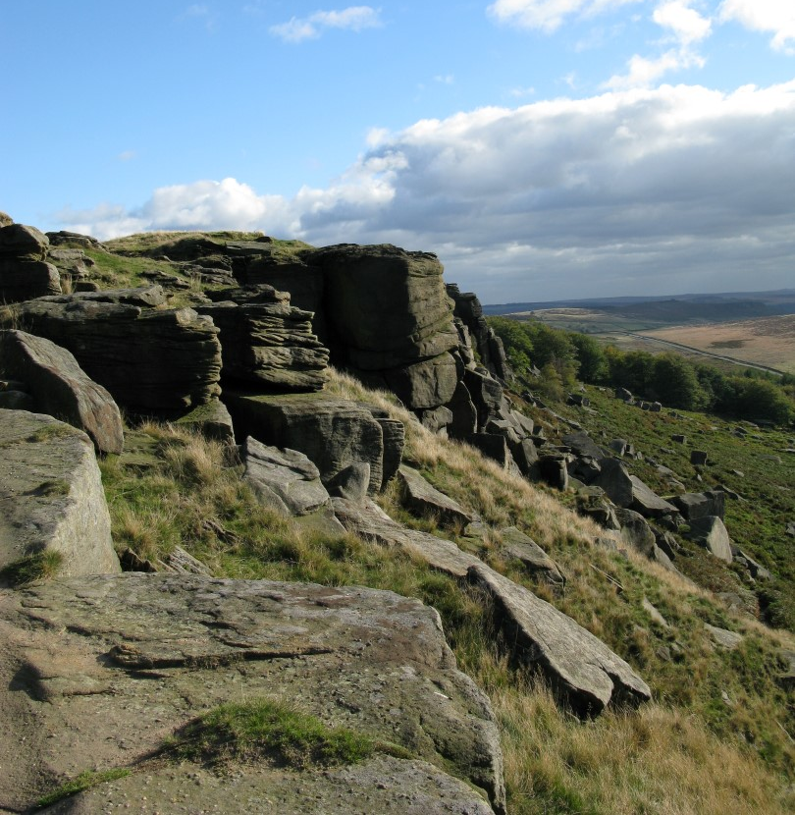
Sandstones
These are younger than the limestones at around 330 – 300 million years old. They contain a mixture of fine and coarse sands, and sometimes also small pebbles.
These rocks are seen in an area of the Peak District called the Dark Peak.
Can you guess why it is called the Dark Peak?

Slide 10
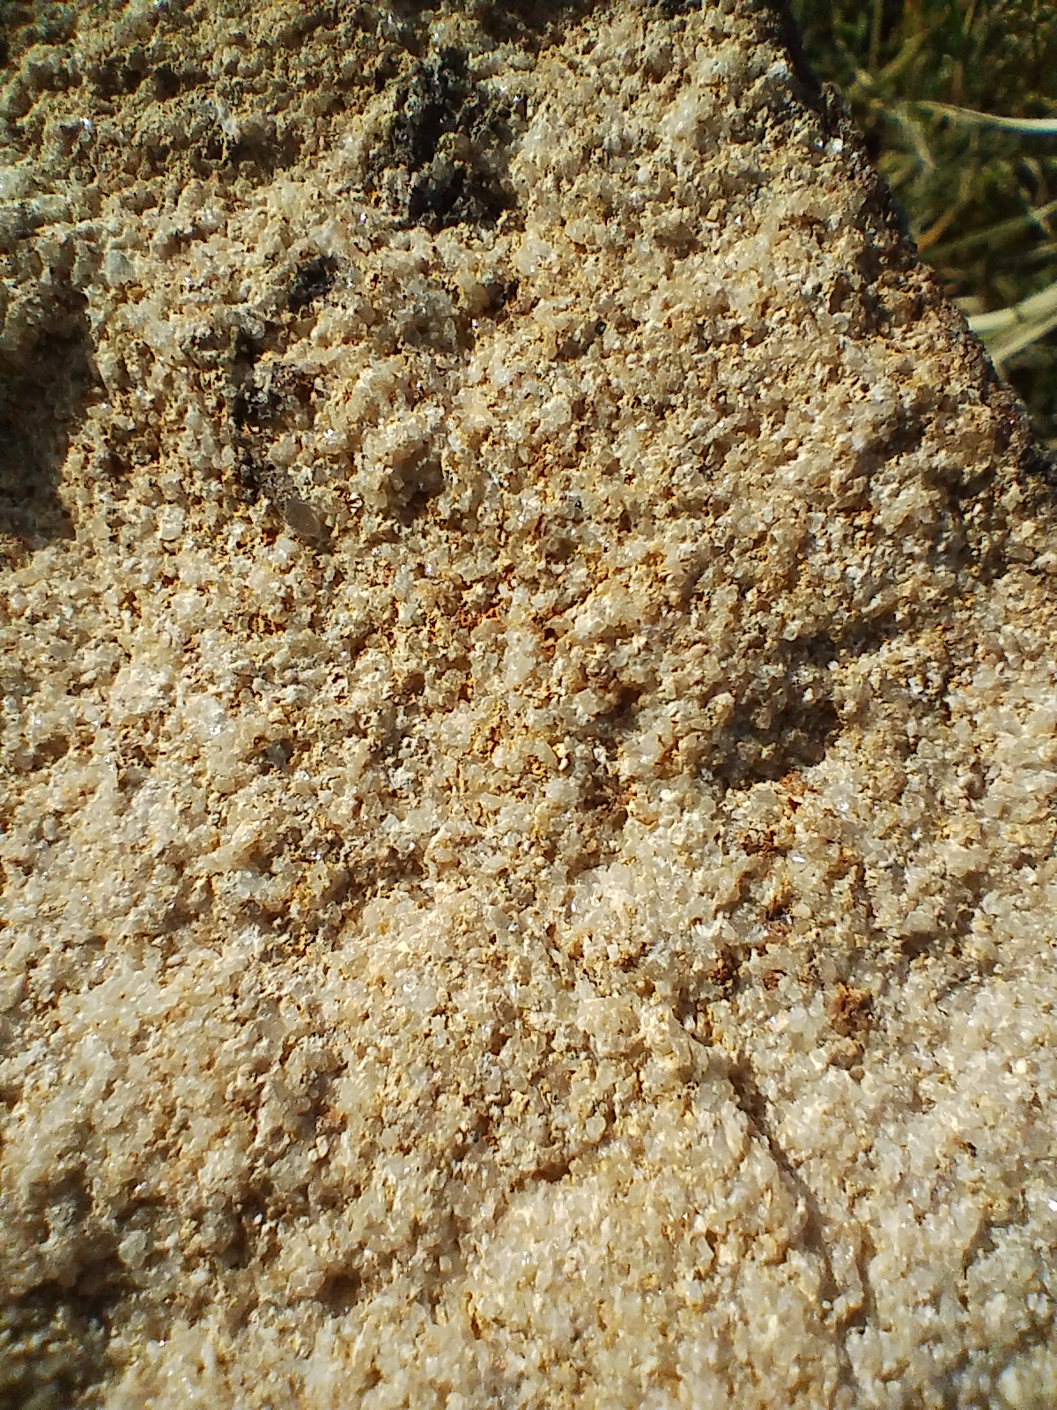
Sandstones
There are fewer fossils in these rocks because they were deposited in huge rivers and deltas.
The coarse sandstones are locally called ‘gritstones’. Can you see why?

Slide 11
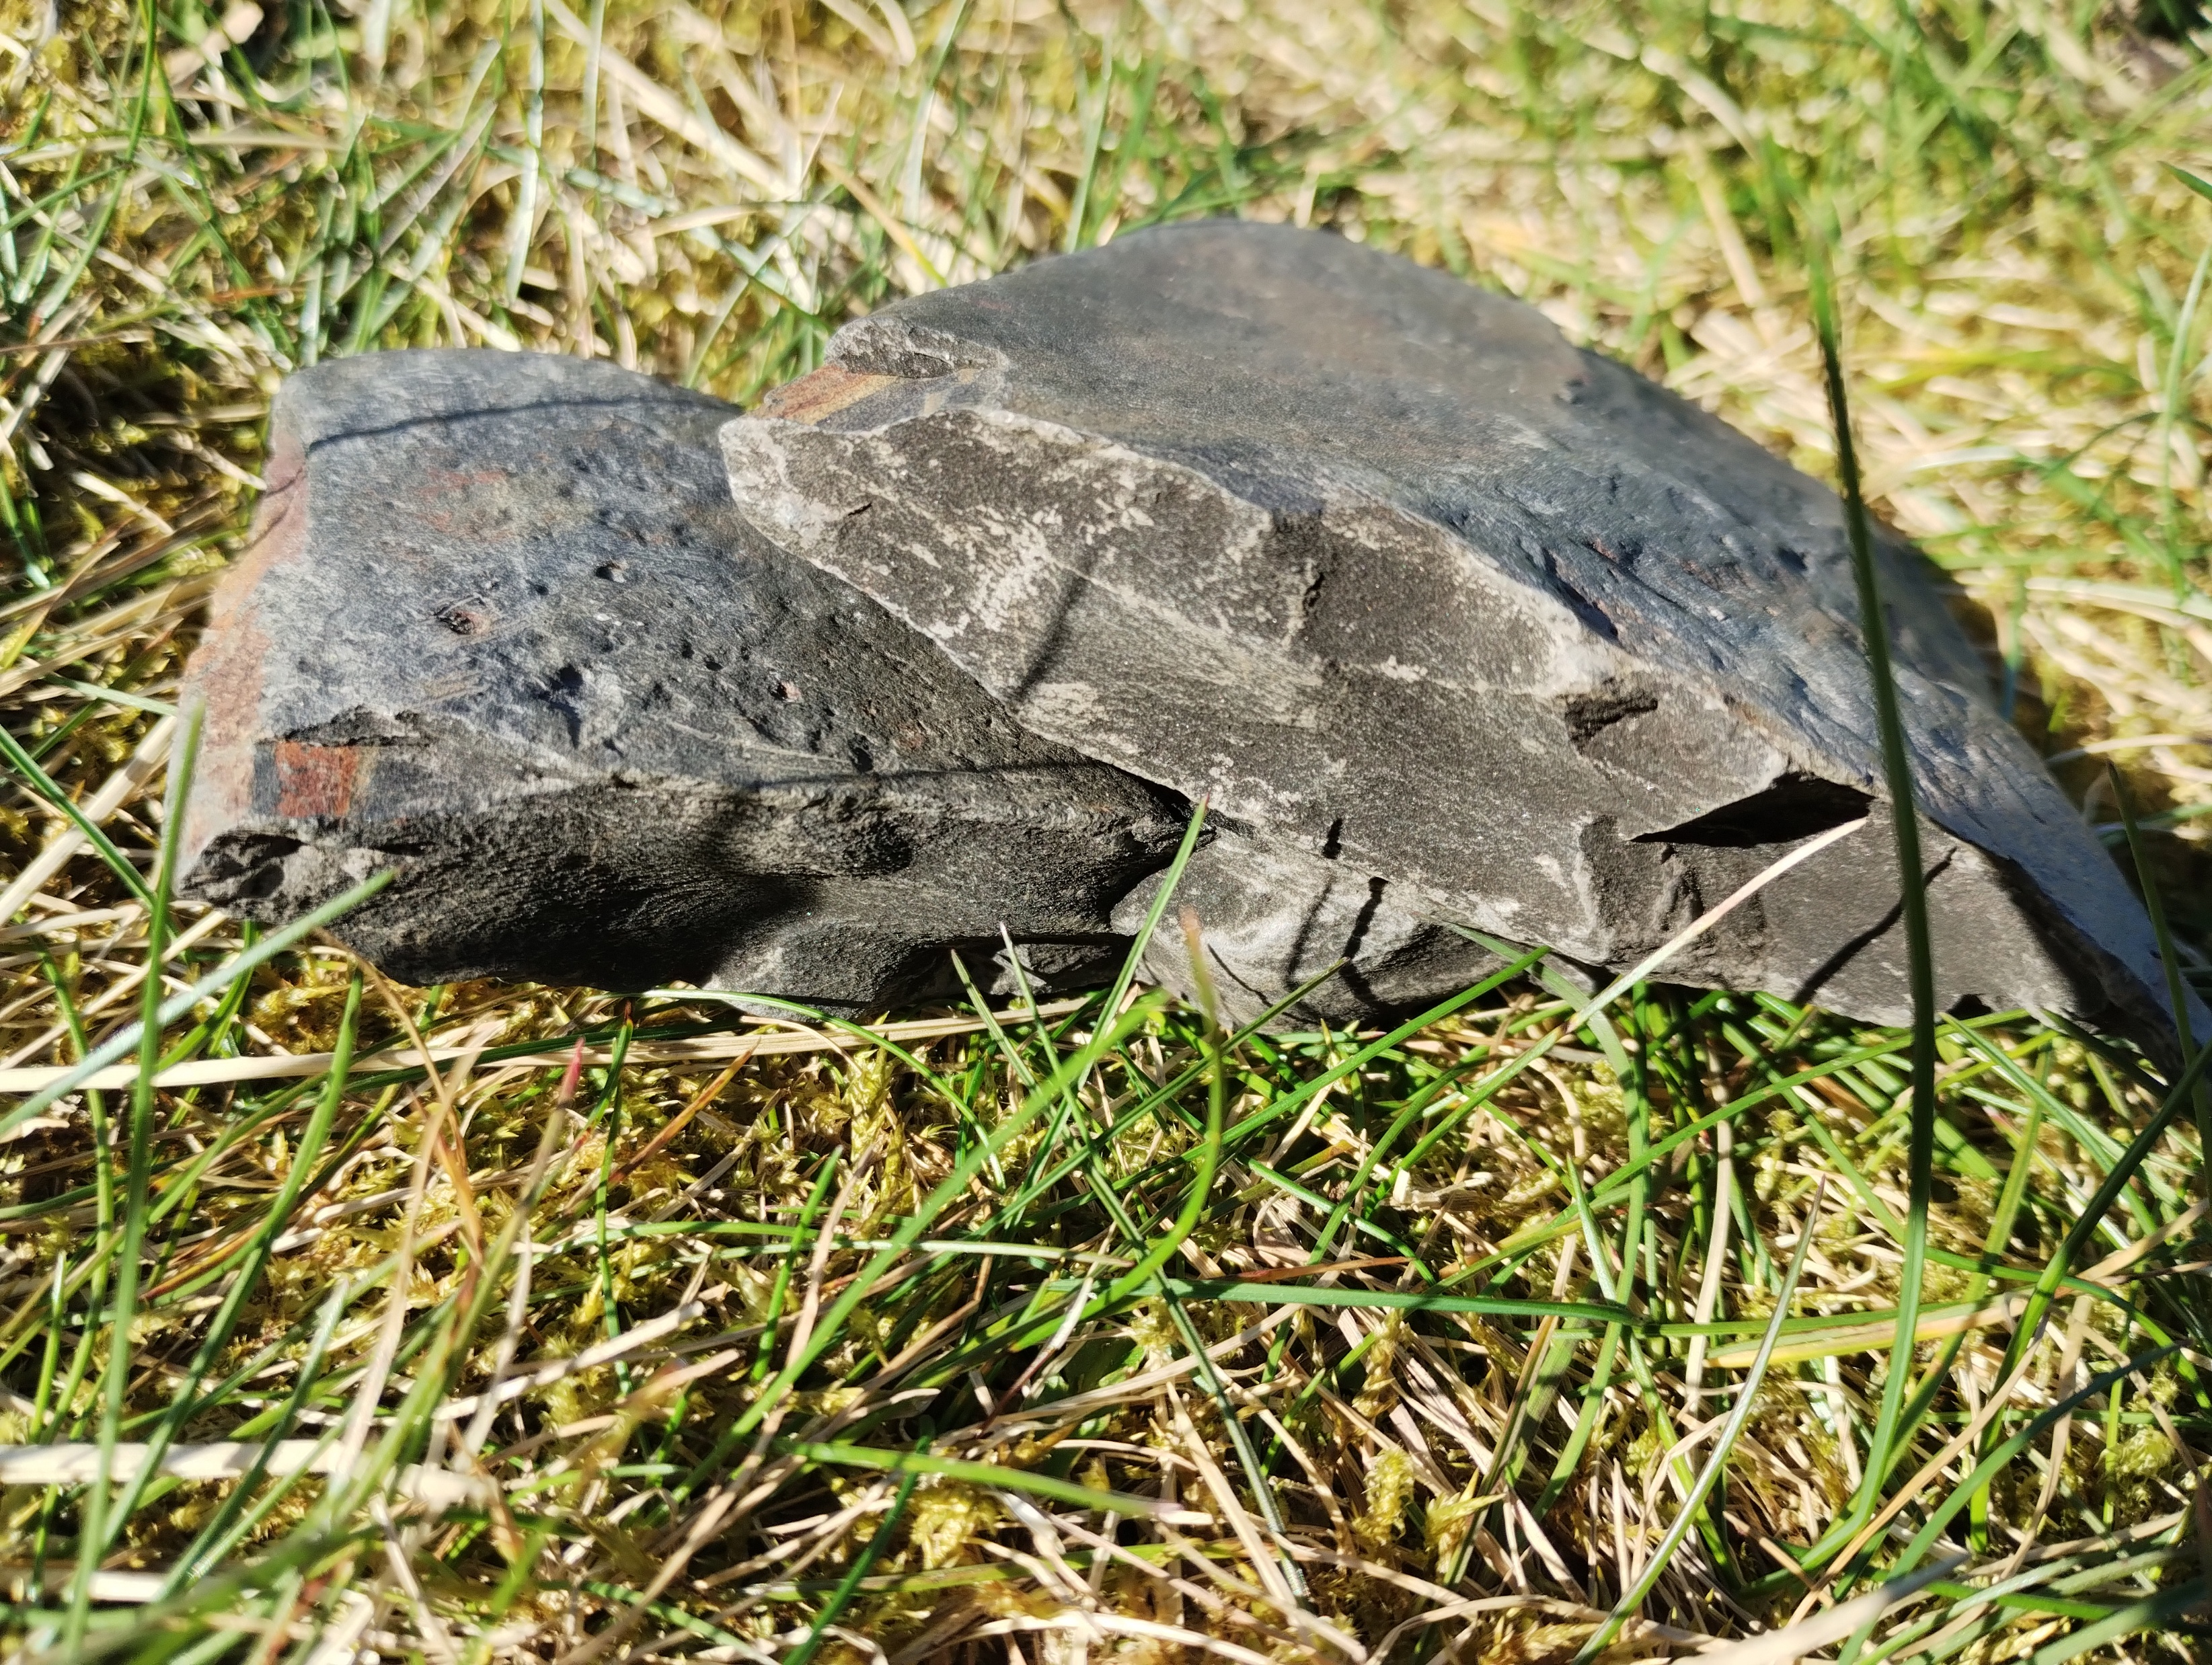
Shale
Shale is a rock made of very fine grained sands and muds. These are often seen layered in between beds of coarser sands.
Do you think the ancient rivers had more or less energy when they were depositing shale?

Slide 12
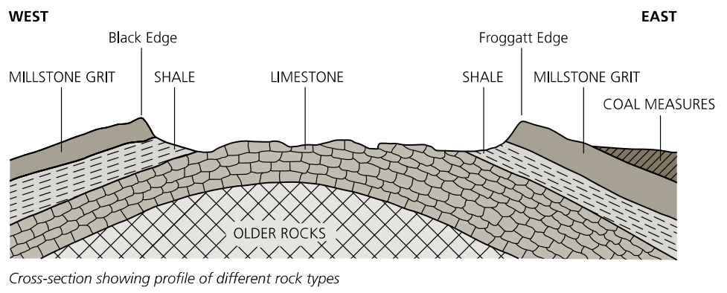
So how did all of these rocks get to the surface?
Over millions of years, tectonic movements have folded the rocks into a gentle dome and lifted them up.

Slide 13
So how did all of these rocks get to the surface?
Once the rocks were exposed as land, weathering and erosion has worn them away.
Can you think of any ways in which rocks can be eroded ?
Look again at the diagram on the previous side. Which rocks do you think will wear away first?

Slide 14
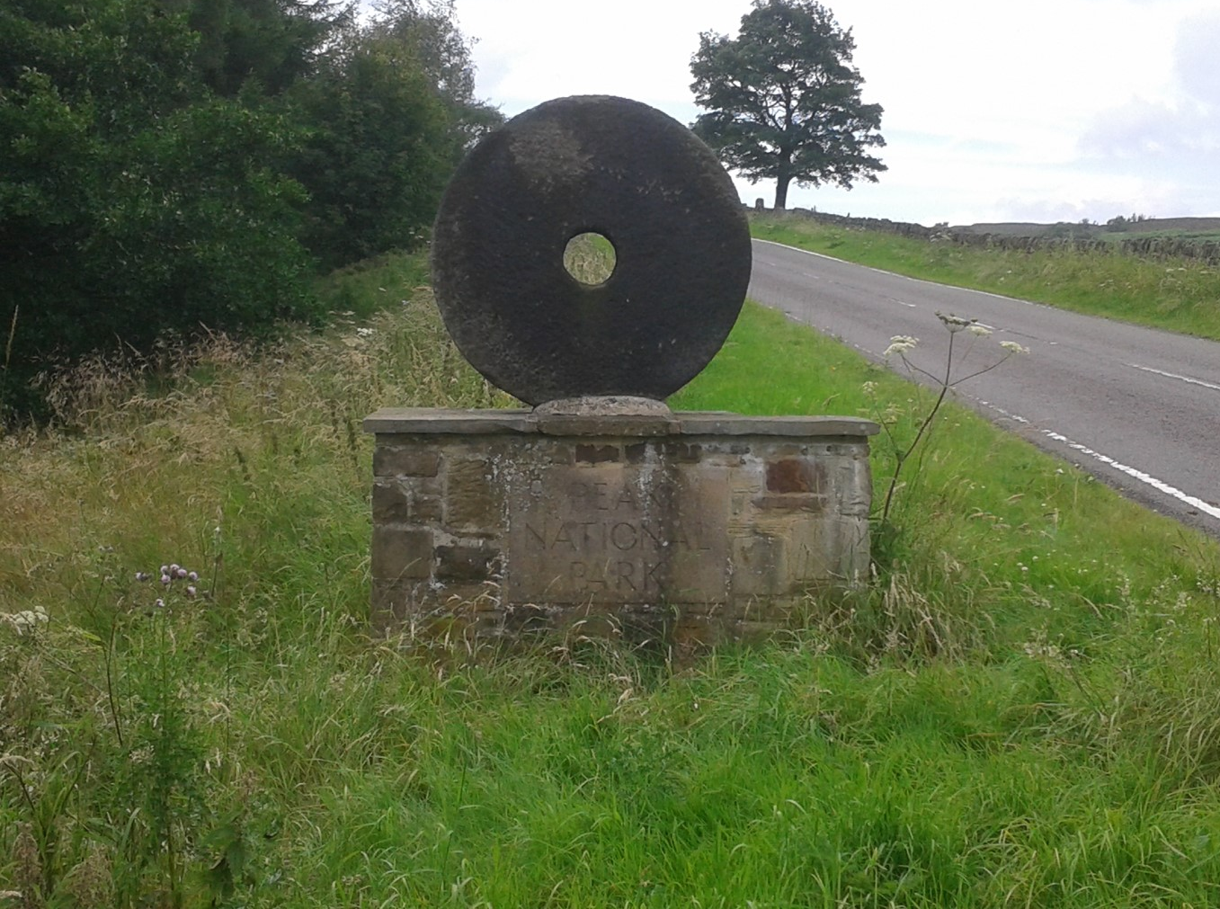
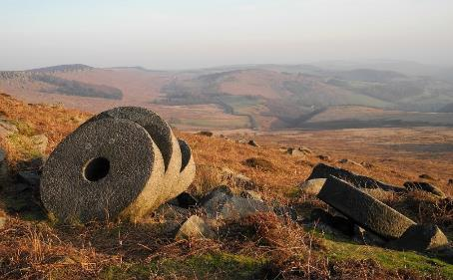
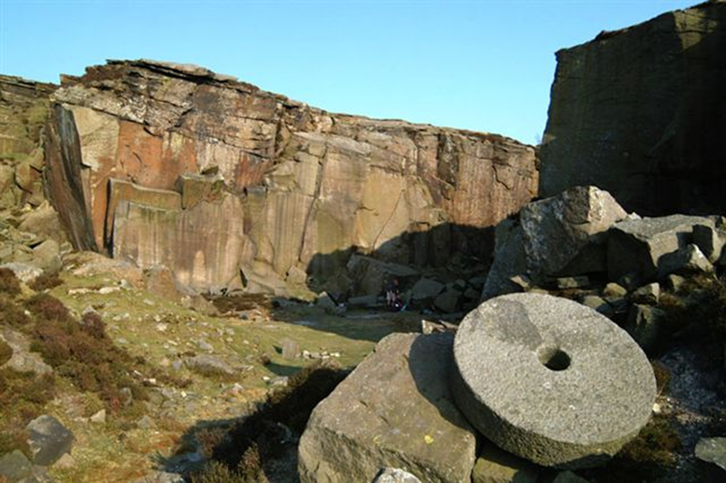
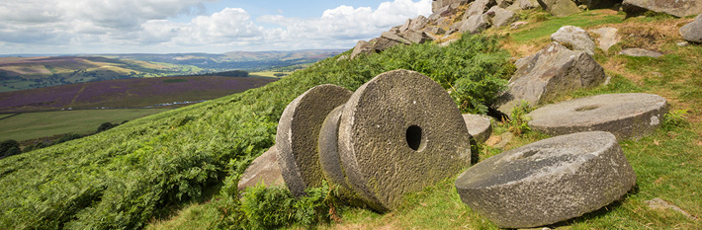
Some famous Peak District rocks
Millstones made from the ‘Millstone Grit’

Slide 15
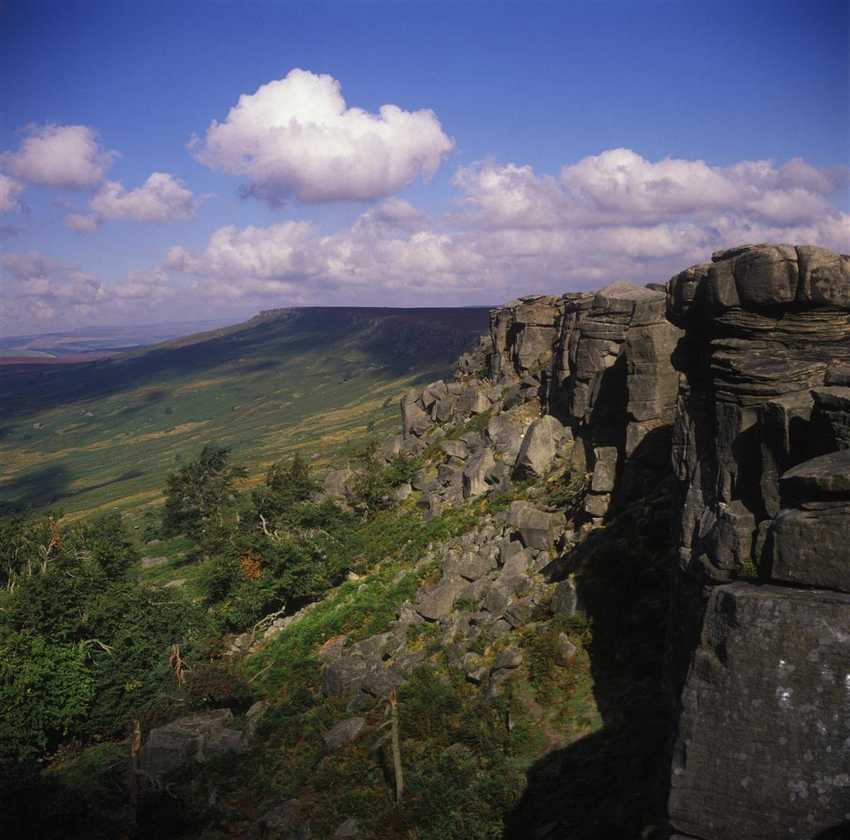
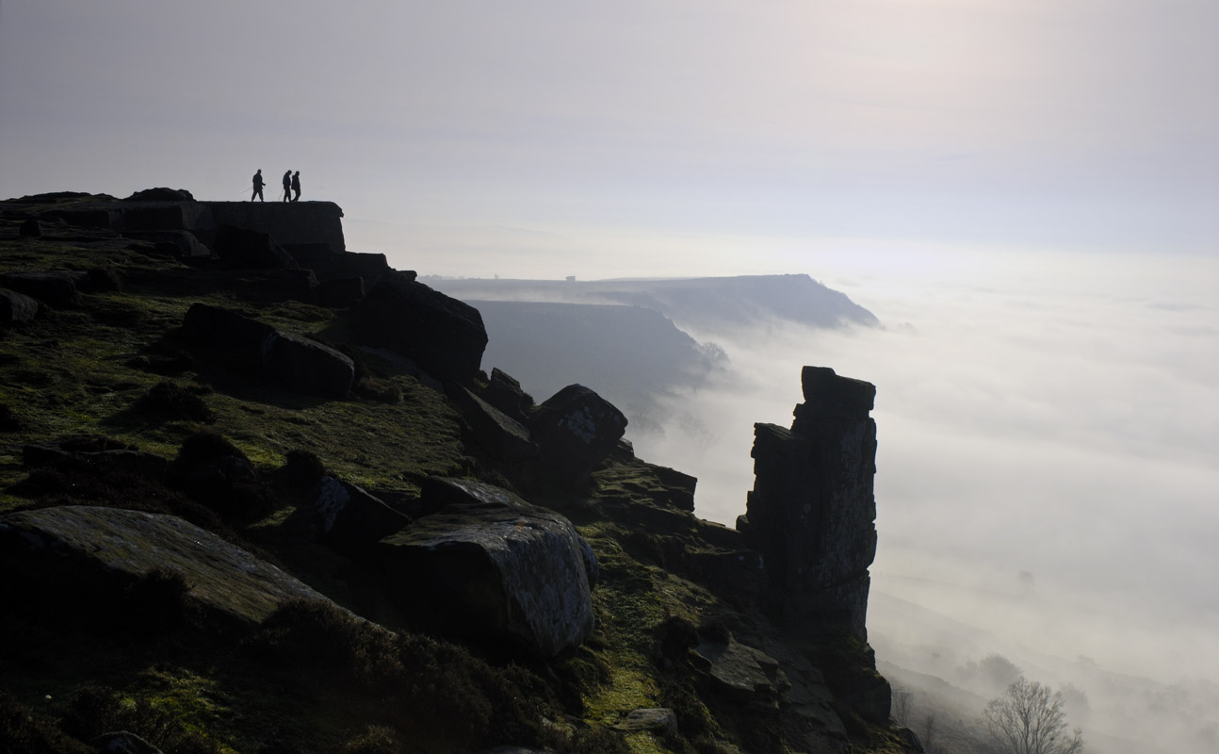
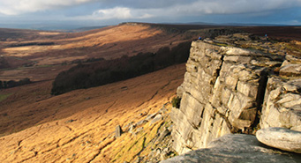
Some famous Peak District rocks
The Gritstone edges such as Stanage, Burbage, Curbar and The Roaches

Slide 16
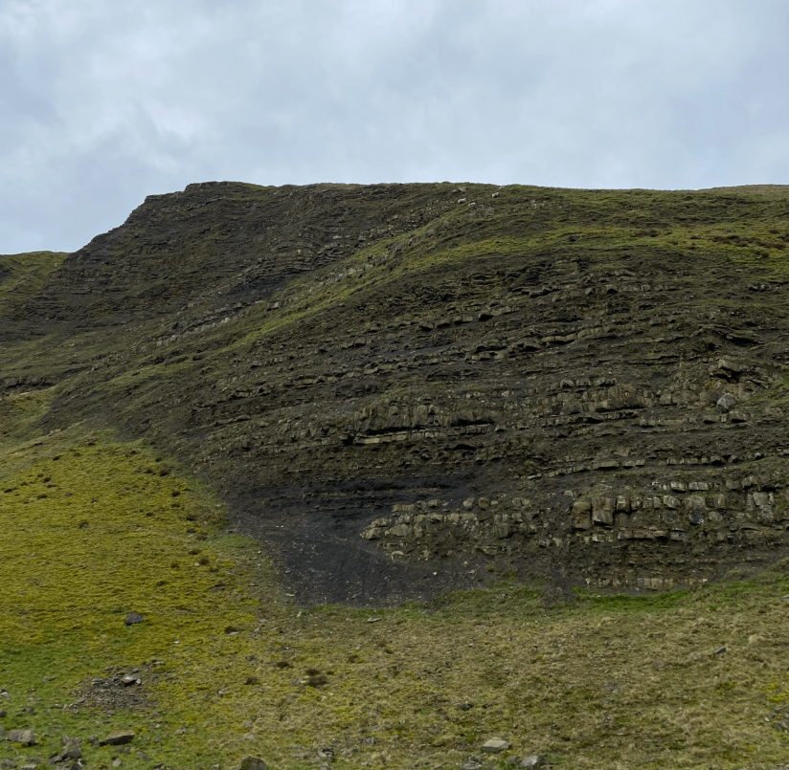
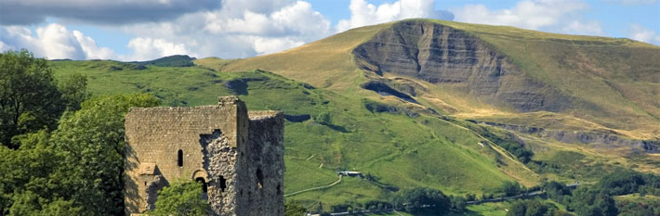
Some famous Peak District rocks
Mam Tor – The Shivering Mountain

Slide 17
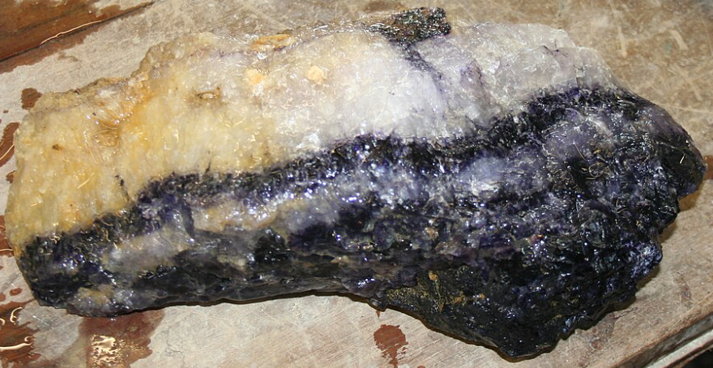

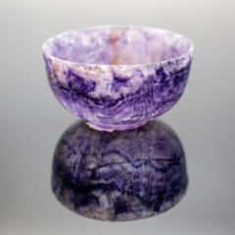
Some famous Peak District rocks
Blue John
Images from Stunning Showcave and Working Blue John Mine | Treak Cliff Cavern

Slide 18
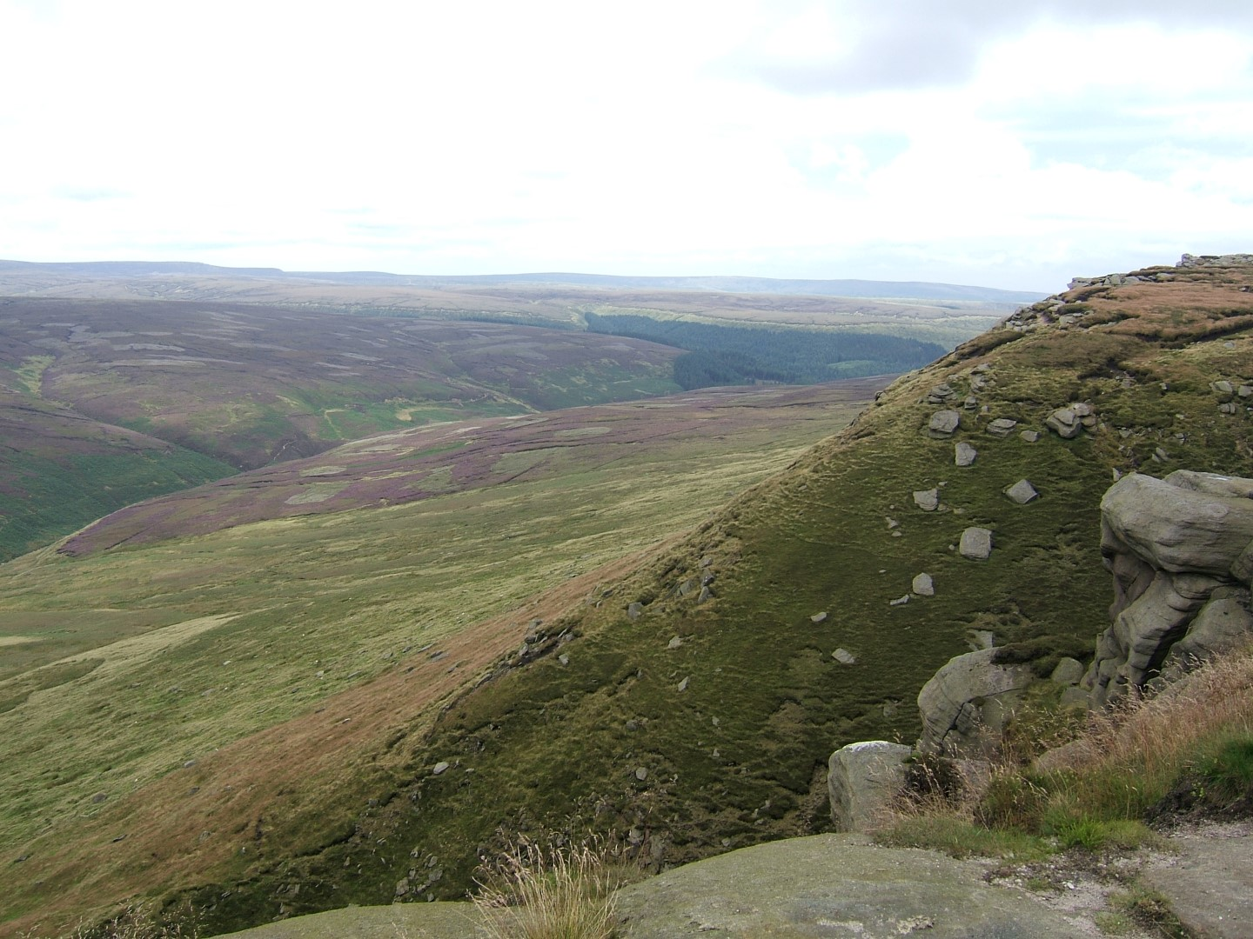

Some famous Peak District rocks
Kinder Scout

Slide 19
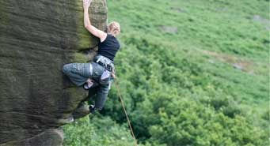
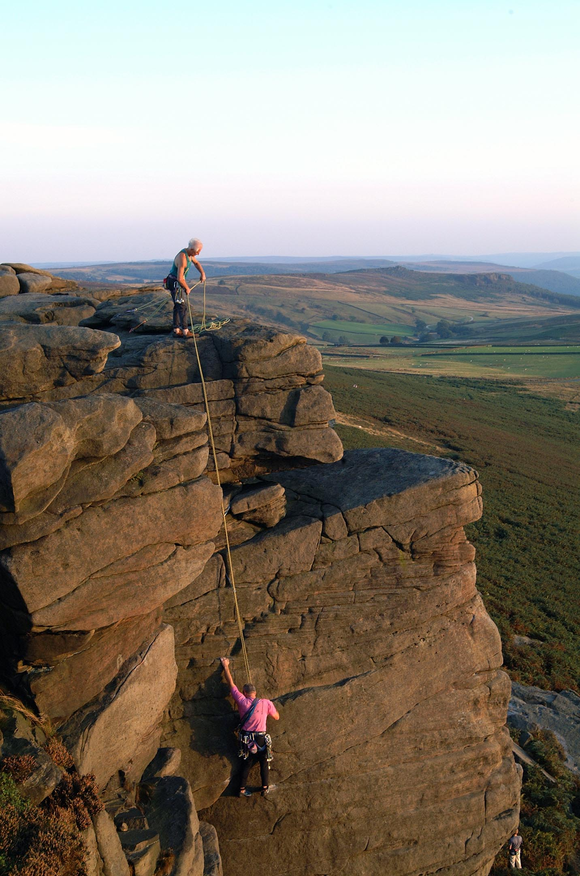
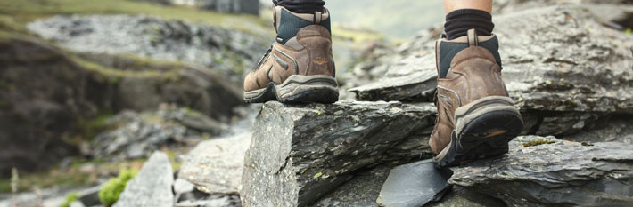
How might the rocks change in the future?

Slide 20
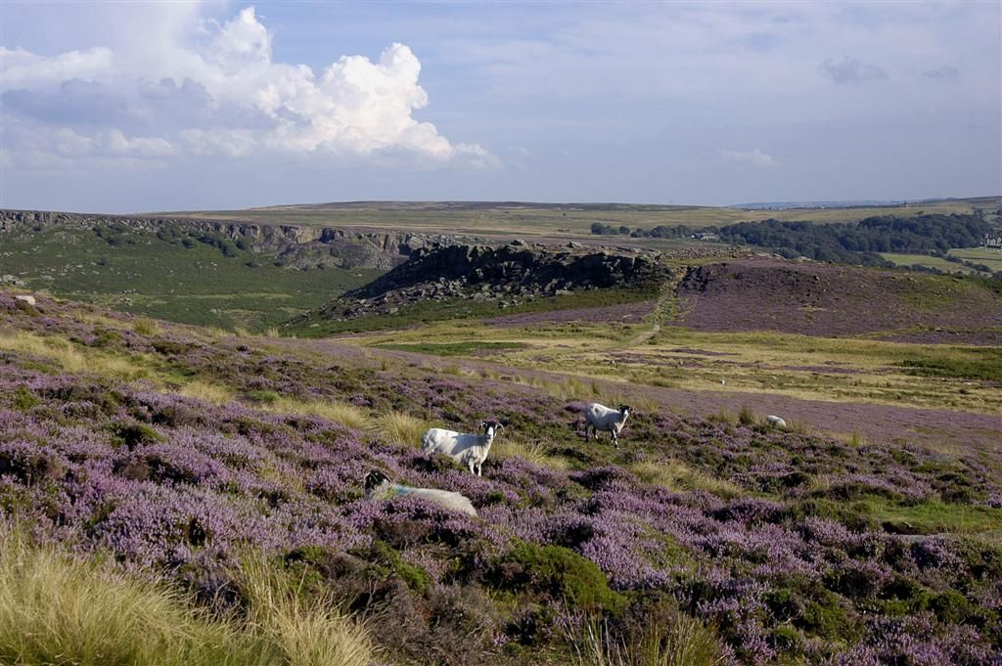
Where would you like to visit?

