Slide 1


Peat in the Peak:
Peat in Trouble

Slide 2
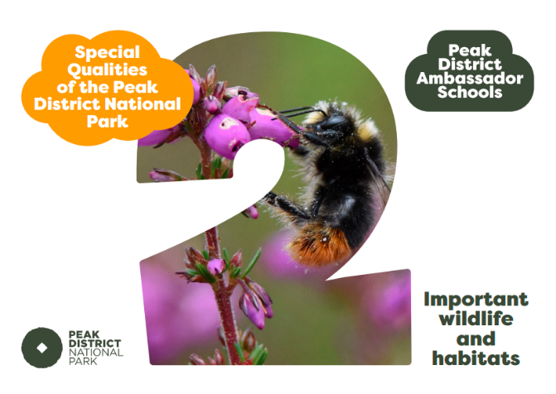
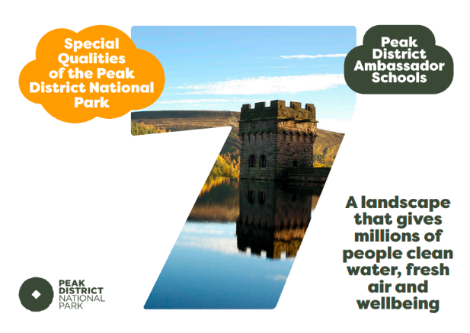

Slide 3
Key Vocabulary
Degraded – In a bad or broken state
Vegetation – a large group of plants growing together
Eroded – worn away by wind, water and human activity
Replenish –fill something up again

Slide 4
Recap - Why is peat special?
Give 4 reasons why we should look after peat soil

Slide 5
Recap - Why is peat special?
Give 4 reasons why we should look after peat soil
Peat is a rare type of soil so what is left needs protecting
It is home to lots of wildlife, some of which can only be found on peat soil
Healthy peatlands are a carbon sink, storing lots of carbon!
Healthy peat helps to reduce flooding in nearby towns

Slide 6
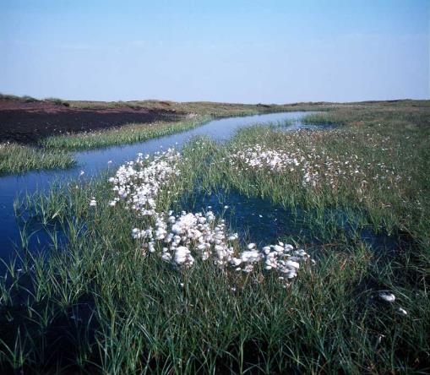
Peat in trouble
through human activity
Across the globe 25% of peatland has been destroyed
10 million tonnes of carbon dioxide are being released into the atmosphere from peatlands in the UK each year through human activity
In the UK, 80% of peatland is damaged

Slide 7
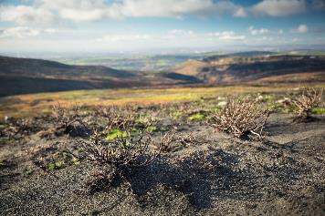
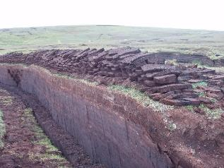
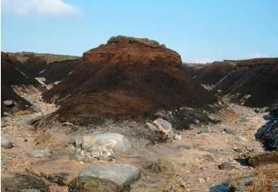
Peat in trouble
The following slides will show threats to peat in the Peak District.
Each threat degrades the peatland by REMOVING it or EXPOSING it.
Image: Moors for the Future
Image: Rog Frost / Peat Cutting near the Simli Field, Shetland^{2.0}
Image: Moors for the Future

Slide 8
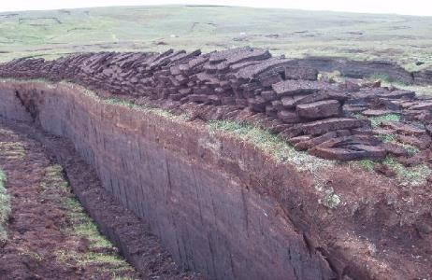
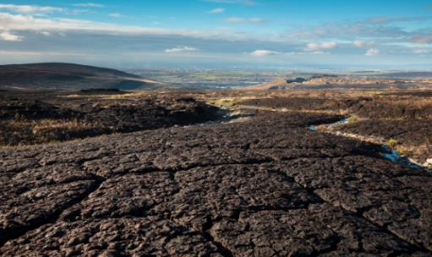
Peat in trouble
  EXPOSING peat – The living layer of vegetation is removed leaving the peat bare
  REMOVING peat – the peat is taken away and used somewhere else
Decide on each following slide if the threat is REMOVING or EXPOSING peat
Image: Rog Frost / Peat Cutting near the Simli Field, Shetland^{2.0}
Image: Moors for the Future

Slide 9
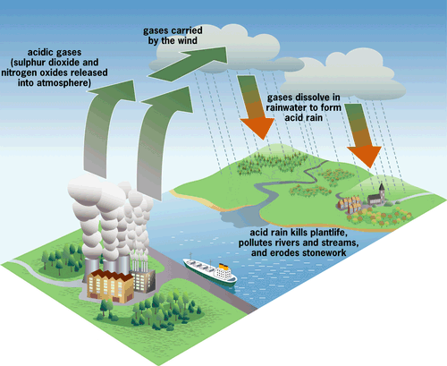
Acid rain
REMOVING or EXPOSING peat?
The Industrial Revolution caused an increase in acid rain by burning fossil fuels for energy
The acid rain killed lots of the sphagnum moss in the Peak District, leaving some peat without any vegetation growing on it
Image: Siyavula Education ^{2.0}

Slide 10
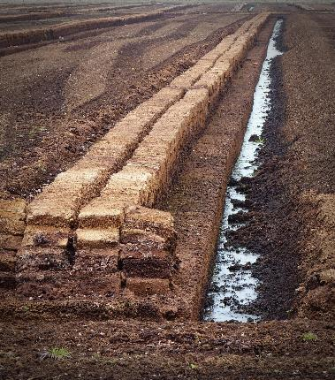
Burning peat for fuel
Peat burns really well so is good to use as fuel on a fire
The peat is dug out and then dried to remove all the water so it burns easier.
For some people it is much cheaper than using oil or gas to heat their home
REMOVING or EXPOSING peat?
Image: Public Domain

Slide 11
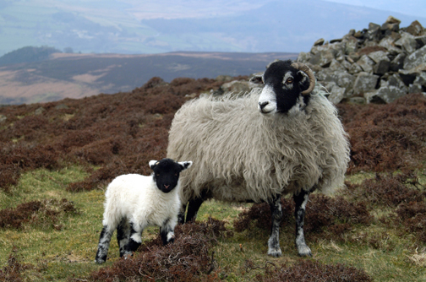
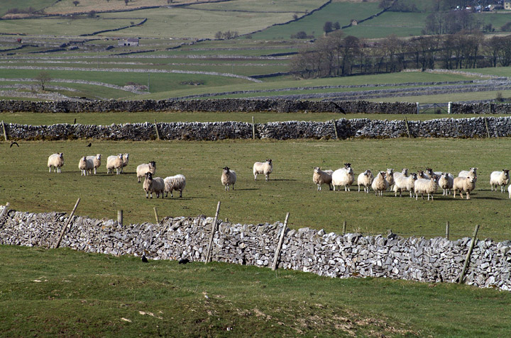
Sheep
REMOVING or EXPOSING peat?
Lots of the Peak District is farm land meaning there are lots of sheep!
Sheep eat the vegetation meaning the moorland loses lots of important and/or rare plants and grass starts to takes over
Some of these plants help keep peat healthy

Slide 12
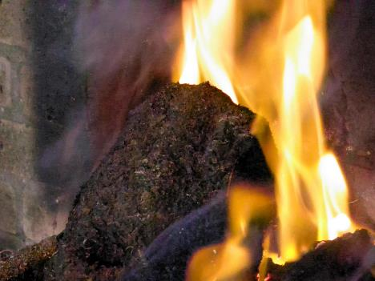
Burning peat for fuel
Fires take a lot of fuel with a family easily using a metre cubed of peat in a month or less – this is around a tonne of peat!
How long would it take a metre of peat to build back up? (replenish)
Hint: It takes 1 year for 1mm of peat to build up….
Image: © Rhonda Surman 2009³
Image: Public Domain

Slide 13
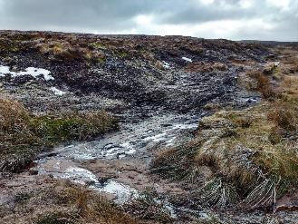
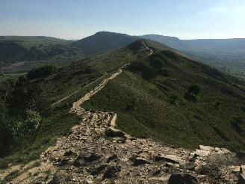
Visitors
The Peak District is very popular with lots of people coming to visit it.
When people walk through vegetation, they trample and damage it eventually leading to bare ground.
REMOVING or EXPOSING peat?
Photos: Carey Davies, Mend our Mountains

Slide 14

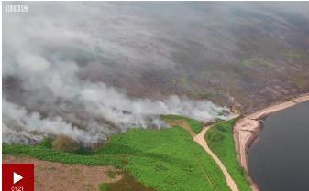
Accidental fires
Watch the videos and answer the following questions:
(1085) Moorland Fire Fighting (April 2009) - YouTube
What can cause fires in the Peak District?
Why are fires in the Peak District difficult to put out?
Saddleworth Moor fire: Drones capture vast moorland blaze - BBC News
Image: Moors for the Future
What damage do fires cause?

Slide 15
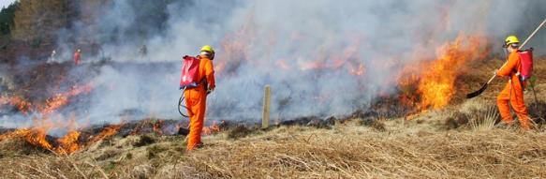
Accidental fires
REMOVING or EXPOSING peat?
Accidental fires can be started by BBQ’s, campfires, cigarettes or litter.
Peat burns very well so the fires often cover large areas making them difficult to stop.
The fires destroy the vegetation
Image: Moors for the Future

Slide 16
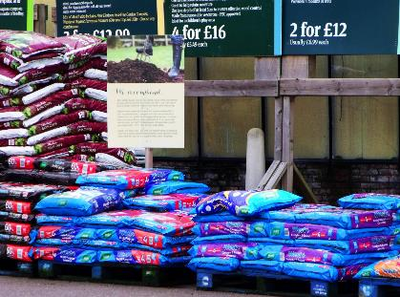
Gardening
Peat is used in compost for gardening
This has meant lots of peat is taken from peat bogs to use in compost
Peat is being used up faster than it can be replenished
The extracted peat releases CO₂
Image: nick macneill^{2.0}
REMOVING or EXPOSING peat?

Slide 17
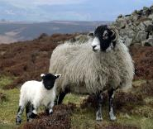
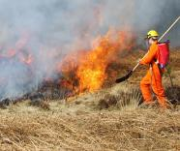

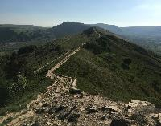

Do you think any of these threats are avoidable?
Split into 6 groups, one for each of the threats to peat.
Acid Rain
Sheep Grazing
Fires
Burning Peat
Path Erosion
Moors for the Future
Peat compost
© Rhonda Surman 2009³
Carey Davies, Mend our Mountains
nick macneill^{2.0}

Slide 18
Do you think any of these threats are avoidable?
In your group answer the following questions:
Why does your threat happen?
  Hint: Do humans benefit by causing damage to the peat in this way?
Do you think your threat is avoidable?
  Hint: Could we get the same benefit in a different way that causes no/less damage to the peat?

Slide 19
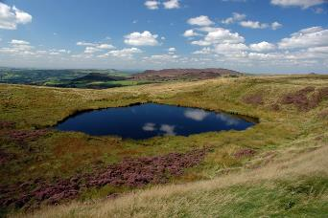
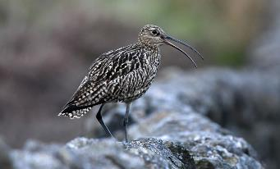
What happens if peat is damaged?
The carbon stored in the peat is released into the air as CO₂ which speeds up climate change
Lots of special plants and animals lose their habitats

Slide 20
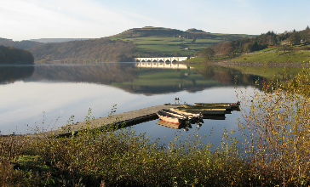
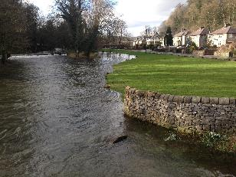
What happens if peat is damaged?
Eroded peat breaks down into small grains called silt, mixes with water in streams and rivers and goes into the reservoirs. It is expensive to clean the water to make it suitable for drinking.
Flooding in nearby towns will increase
Why does this happen?
Image: Public Domain

Slide 21
Create your own quiz!
Discuss in pairs what you have found out in today’s lesson
Write down 2 quiz questions and their answers
Give your quiz questions back to your teacher
Your teacher will ask a few questions now and save a few for the start of the next Peat in the Peak lesson!
Image: Public Domain

Slide 22
What next?
Fill in the “Peat in trouble” and “What happens if peat is damaged?” boxes on the ‘Peat in the Peak’ summary worksheet.
You could create a poster to educate people on one of the threats to peat and how they can help
Look at our next and final lesson in the ‘Peat in the Peak’ series: Restoring the peat.
Image: Public Domain

Slide 23
Image Permissions
  Photo licencing
    If no reference given the Peak District owns or has full permission to use the image
    If referenced and followed by ¹ the following Creative commons license applies: Creative Commons — Attribution 2.0 Generic — CC BY 2.0
    If referenced and followed by ² the following Creative commons license applies: Creative Commons — Attribution-NonCommercial 2.0 Generic — CC BY-NC 2.0
    If referenced and followed by ³ the following Creative commons license applies: Creative Commons — Attribution-NonCommercial-NoDerivs 3.0 Unported — CC BY-NC-ND 3.0

