Slide 1


^{The Countryside Code,}
^{Keeping Special Places Special}
Understanding rights and responsibilities: The Countryside Code
KS2 Lesson 1 - Presentation

Slide 2
Key vocabulary
Rural – Countryside areas
Urban – Town and City areas
Agriculture – Areas of farming including crops and animals
Rights of Way – Network of footpaths, bridleways and cycle paths

Slide 3
The Countryside Code
The Countryside Code was first created in the 1930’s and was called the country code. It is a set of rules for visitors to rural and especially agricultural areas of England. The Countryside Code is still important today and in 2020 the government updated the code to make it more suitable for today’s visitors. During the COVID-19 pandemic this helped manage the increased number of people accessing the countryside.

Slide 4
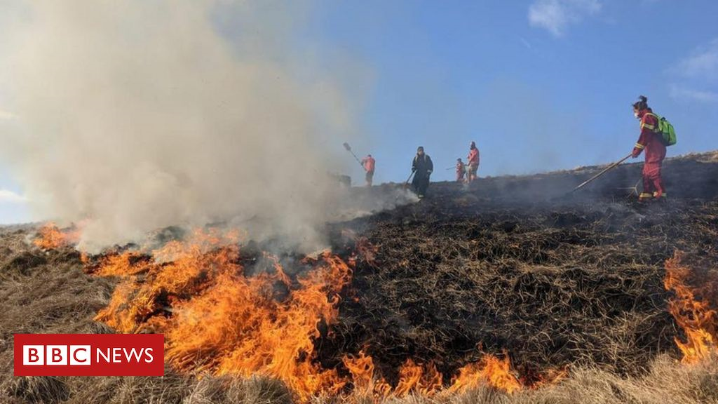
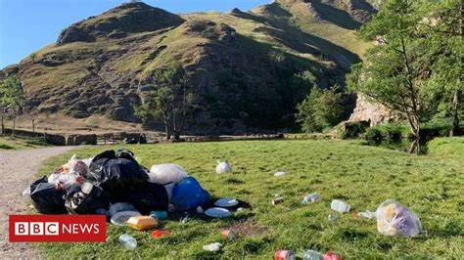
Is the Countryside Code still important?
As more people want to access the countryside for enjoyment, wellbeing and connection
with nature it’s important we continue to balance visiting with looking after the environment.
Newsround clip on the Country Code today (1.07min)
https://www.bbc.co.uk/newsround/56595869
BBC News image April 2021 of a wildfire at Rushup Edge in the Peak District National Park
BBC News image June 2020 of litter at
Dovedale in the Peak District National Park

Slide 5
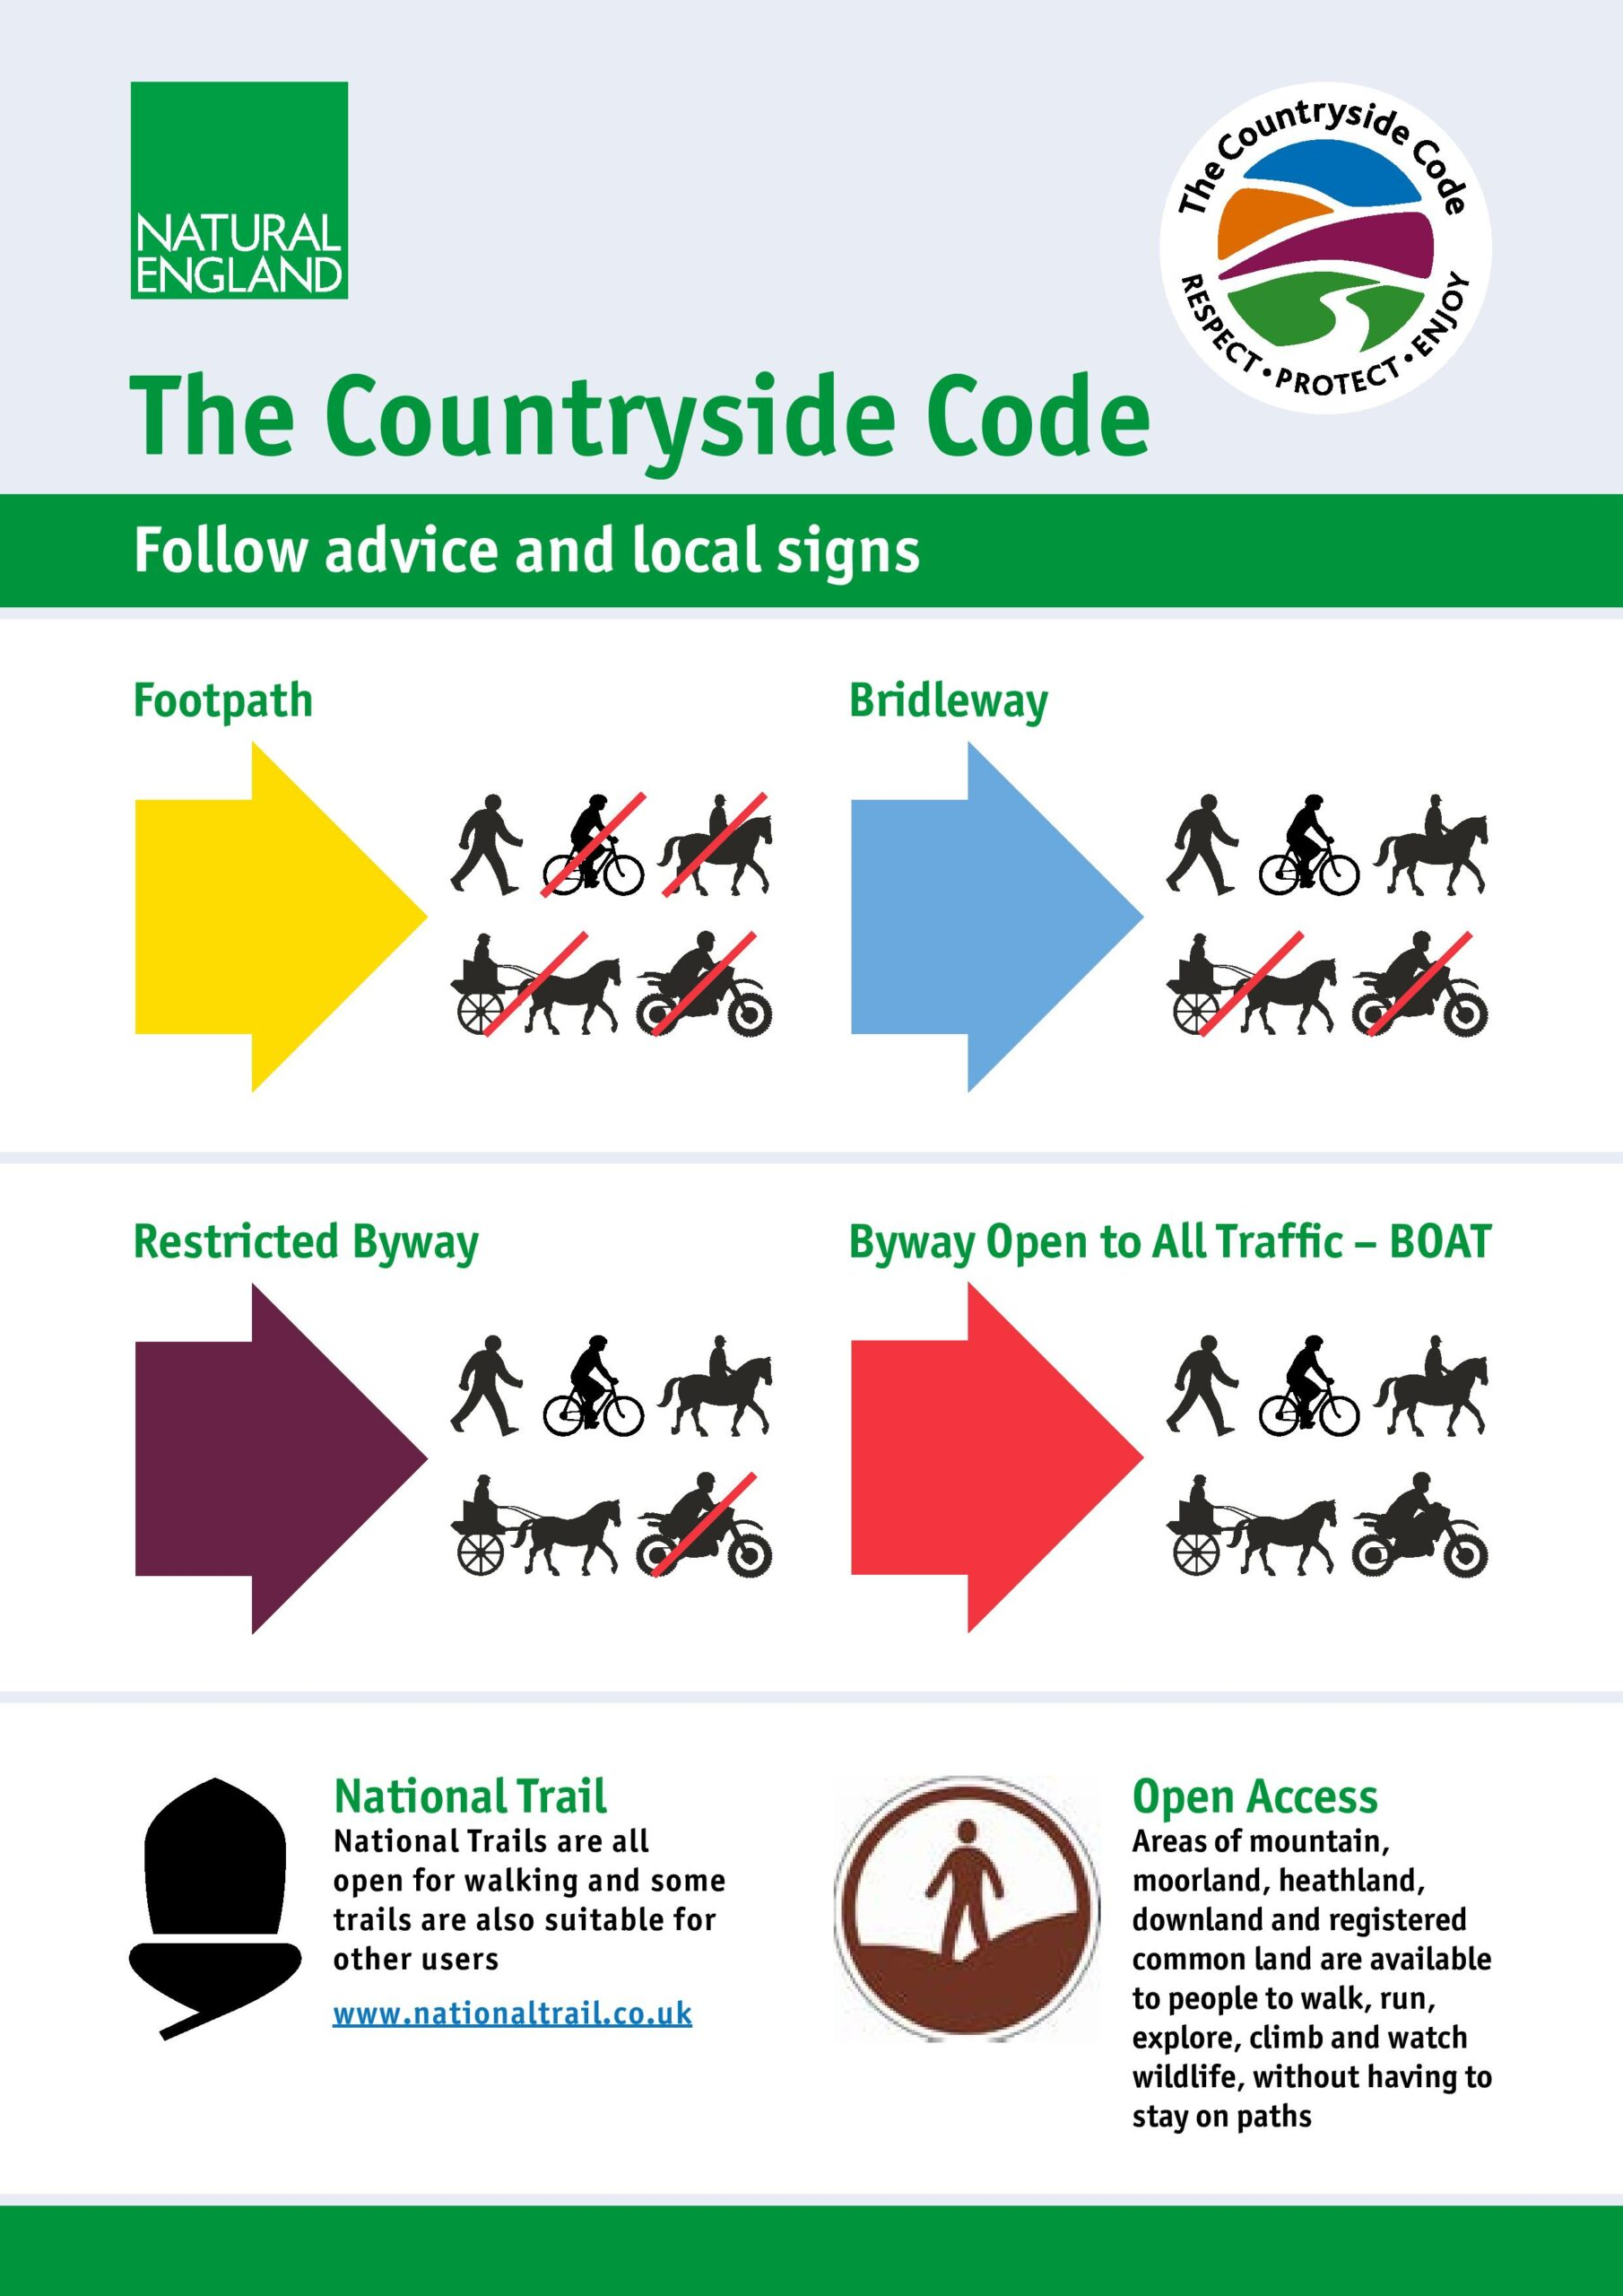
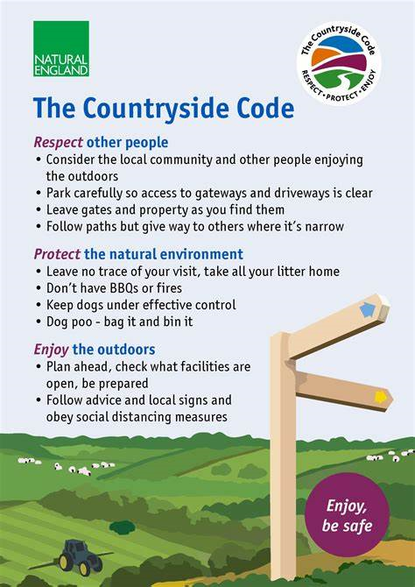
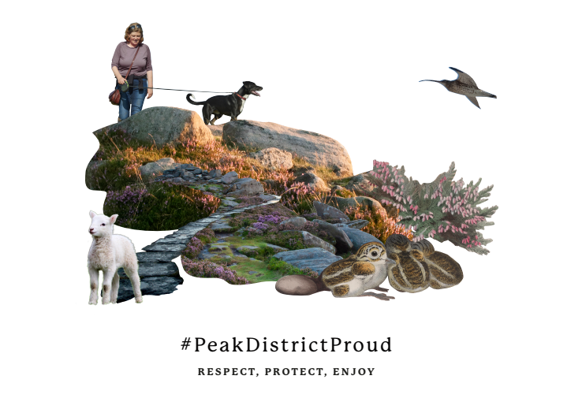
Countryside Code in use

Slide 6
The Countryside Code in use
1. Creature Comforts Countryside Code animation (1.01 min)
The Countryside Code (2004, UK) - YouTube
2. Peak District National Park Do This animation (1.36)
Animation for the Peak District National Park - YouTube

Slide 7
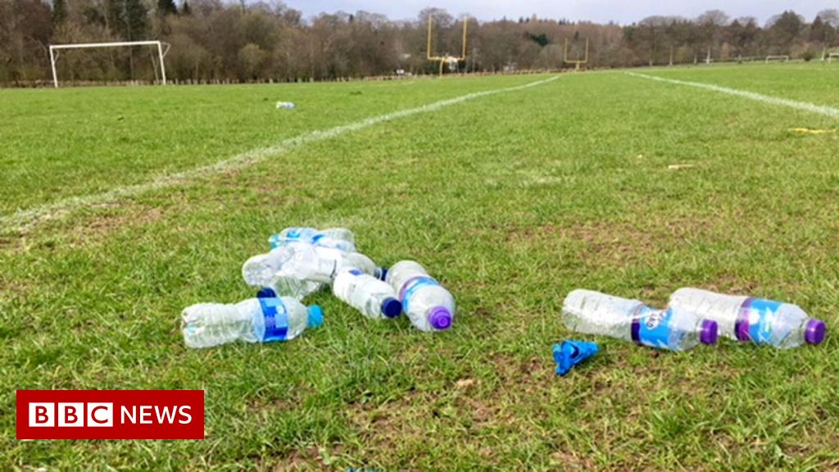
Keeping special places special
The Countryside Code is aimed at giving advice and information about visiting rural areas but there are many urban areas that are important to people and wildlife that suffer with similar problems.

Slide 8
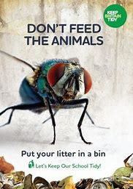
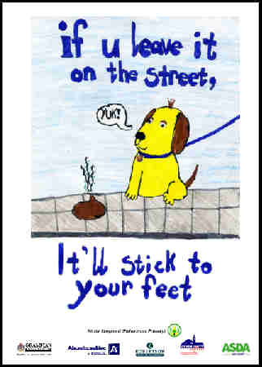
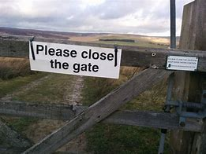
Keeping special places special
#PeakDistrictProud
Respect, Protect, Enjoy
Take only memories, leave only foot prints

